Slide 2
The virtual musculoskeletal (MSK) clinic in your pocket
Company Introduction | Summer 2021

Slide 3
3
Use the symptom assessment tool to identify your injury and learn about what causes the problem and what you can do about it.
Introduction
Identify what’s wrong.
What is Upswing?
A new way to diagnose and treat orthopedic problems.
Connect with a health coach or orthopedic physician who can answer your questions and guide you through a home-based rehab program or get you to the best in-person doctor for your condition.
Member Introduction
Get better.
Get immediate help from the comfort of your home using Upswing’s simple and intuitive tools, all 100% included in your benefits package (no additional fees for using Upswing).
Free and convenient to members

Slide 4
4
Eligibility
Who is eligible and what does it cost?
I cannot believe how great my back is doing! I've been doing my exercises before work every morning and I'm already feeling so much better! I'm going to start playing tennis soon thanks to how great I feel!”
-- Michael G.
All employees or members of the program, plus their dependents, are eligible for this free service. However, anyone under the age of 18 will need their legal guardian to be present at the time of the consultation in order to receive healthcare services.
What’s more, the service is 100% free to use as often as desired.
PROPRIETARY & CONFIDENTIAL

Slide 5
5
Use Cases
Something bothering you, and you don’t know what it is or what to do? From twinges in your elbow to aches in your knees, from pain in your toes to a sore back, Upswing can help. No one should suffer from pain needlessly.
Annoying Aches and Pains
What’s it for?
Have a serious problem and want to see a doctor? Upswing’s orthopedic physicians are here to help. They will diagnose your condition and get you on the right track for recovery – whether that’s physical therapy or in some cases, a referral to an orthopedic surgeon for further assessment.
Virtual Doctor Visits
PROPRIETARY & CONFIDENTIAL
Sprained your ankle and unsure what to do? Upswing’s triage team is standing by 7 days a week to help with any orthopedic emergency They can help you decide if you need to make a trip to urgent care or if you can wait for a standard office visit. And they will give you advice on what to do in the interim.
Emergency Advice
My health coach was the best! She kept checking in to make sure I was doing the exercises and making sure things were getting better.
-- Helen S.
Already have a diagnosis, but still have questions? Upswing’s health coaches and physicians are experts in orthopedic care and can help any questions or address any concerns you might have about treatment options.
2nd Opinions

Slide 6
6
HOW IT WORKS
Upswing is an end-to-end care approach to treat MSK quickly, efficiently, effectively.
Digital Symptom Assessment
Member Introduction
OUCH!
Virtual Health Coach Interaction
Virtual Diagnosis
Virtual therapy
Virtual Physician Visit
Orthopedic Specialist
Imaging
Surgery
Front door of care
Better outcomes start here.
Members use the Upswing platform to triage their condition and get set up on the best path to recovery.

Slide 7
7
Case Study
Upswing offers a better way to treat MSK pain. Just ask Eve.
Upswing begins with a powerful virtual diagnostic tool to start patients on the right pathway, right away.
Member Introduction
Eve, a principal in Connecticut, decided to get a second opinion before a major shoulder surgery.
She used our world-class health symptom assessment tool and got diagnosed with Frozen Shoulder (which was not the diagnosis that led to a recommendation for surgery).
A physical therapy rehab program was set up and she’s rehabilitated back to health.
Upswing kept Eve in good health/back in the office and feeling better without surgery.
Thanks [Upswing] for checking in. I am still following the videos and my shoulder is healing up — no more pain in the morning.
Eve
PATIENT

Slide 8
8
Learn what’s wrong. Knowledge is the best first step. Upswing will help you understand your injury.
Immediate Insight
Discover what to do about it. Upswing will guide you to a set of steps to get you better.
What can I expect by using Upswing?
Expert Advice
Get better, at home. In most cases, Upswing’s platform will help you recover with personalized, guided rehabilitation exercises you can do at home.
Home-based Rehabilitation Program
Member Introduction
Referral to Expert, In-person Physicians
The right doctor for you. When care cannot be done virtually, Upswing will help get you in front of the right person for your care.
We are there for you.
Upswing is always standing by to answer any questions about ongoing care, or new issues as they arise.
Ongoing help

Slide 9
Thank you.
Contact Name adam@upswinghealth.com
917.586.6438

Slide 10
State of Connecticut
Episodes of Care Program
July, 2021

Slide 11
A Partnership Program
State Of Connecticut
Episodes offer higher-quality and more cost effective care that will drive better health and social outcomes for people living across the state
Leveraging the power of the State to shift the healthcare dynamic to more patient-centered, preventive care
Signify + Provider Network + Health Advocate
Network: Signify works directly with Providers for Program Participation, offering:
Materials and tools to help support care redesign and improve patient outcomes
Real-time analytics and reporting to help providers make clinically relevant decisions
Provide patients with accessibility and awareness of the highest quality providers in their network
Notes:
Leslie

Slide 12
What are Episodes of Care?
An episodes program is a health and payment model in which a single, bundled payment includes all services associated with the treatment for an illness, condition or medical event rather than a separate fee-for-service model
An episode includes all clinically related services provided to a patient for a discrete condition or procedure, within a specific period of time, across the entire continuum of care
Office visits, surgical procedures, ancillary services, lab, and pharmacy claims are included
Procedural Episodes
Chronic Episodes
Pre Procedure Window
0-30 Days
Procedure
Post Procedure Window
7-90 Days
Ongoing and annualized into 12-month windows for reconciliation
Notes:
Leslie

Slide 13
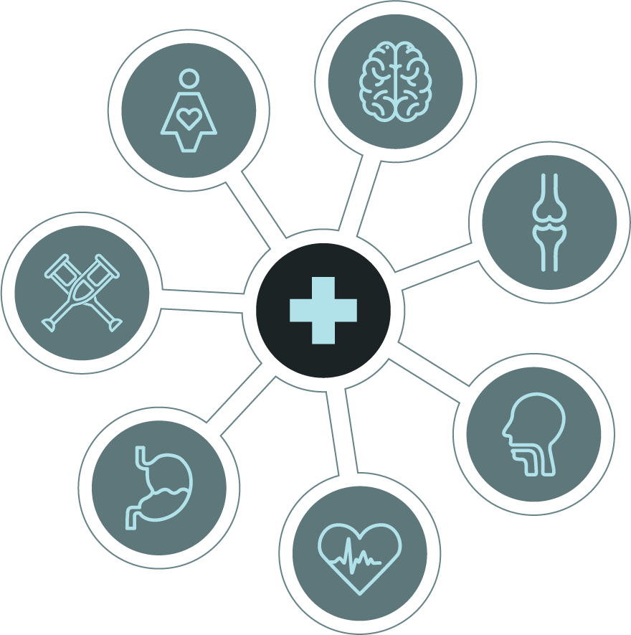
Scope of EOC Payment Programs
Leveraging over 400 episode definitions for our Episode of Care Program
Procedures
Cardiology: PCIs, Pacemaker- Defibrillator, CABG/Cardiac Valve
GI: Bariatric, Gall Bladder, Colonoscopy, Upper GI Endoscopy, Colorectal Resection
Ortho: Hip Replacement, Knee Replacement, Knee Arthroscopy, Shoulder Replacement, Lumbar Laminectomy, Lumbar Spine Fusion
Ophthalmology: Cataract Surgery
Lung & ENT: Lung resection, Tonsillectomy
Women’s Health: Hysterectomy, Mastectomy, Breast Biopsy
Men’s Health: Prostatectomy, TURP
Chronic Conditions
Lung: Asthma, COPD
Heart: Diabetes, CAD, Hypertension, CHF, Arrhythmias/Heart Block
GI: GERD, Chron’s Disease, Diverticulitis
Ortho: Low Back Pain, Osteoarthritis
Maternity
Mother: Pregnancy, C-Section and Vaginal Delivery
Baby: Newborn
Notes:
Leslie

Slide 14
Signify’s Commercial Episode Construction
Total Knee Replacement
Cost of Complication like and infection
Episodes look at all clinically related services for a discrete condition/procedure for the entire continuum of care: management, surgery, ancillary, lab, pharmacy services for a given time frame
Pre-Op Visit with PCP
Claims for typical care and services
Claims for typical care and services
Surgical and
Facility Charges
Pharmacy cost
Irrelevant
Irrelevant
Start
End
30 DAY LOOK BACK
Total Knee Replacement Procedure
- - - - - - - - - - - 90 DAY LOOK FORWARD - - - - - - - - - - -
Notes:
Jared

Slide 15
Patient Journey Through an Episode of Care -
Knee Replacement
Patient does 4 weeks of Physical Therapy with minimal improvement so returns to PCP
Patient talks to their SoCT health plan benefits coordinator who suggests calling Health Advocate or using their website to locate the highest quality surgeon in the Network of Distinction (NOD).
Patient is doing much better 6 weeks later with less pain and improved function
Member has been experiencing knee pain for a few months
Dr. Jones performs the knee replacement procedure
Dr. Jones sees the member and agrees a knee replacement is the best option
Patient receives a monetary incentive for using Dr. Jones
Pre Procedure
Procedure
Post Procedure
PCP performs x-rays and tells member they may need a knee replacement and should see an orthopedic surgeon
Patient finds, Dr. Jones through
Health Advocate
and sets up an appointment
Patient is able to go home the same day
Member sees their PCP who refers them to Physical Therapy
Patient finishes post-op Physical Therapy
Notes:
Jared
Patient can be optimized through the pre-procedure process

Slide 16
Goals of Episodes of Care Quality Program
Goals of Our Quality Programs
Create a quality program to effectively measure improved outcomes in an episodes of care program
Monitor how well the providers are delivering quality care and value, compared to peers
Lay out expectations
Identify areas for improvement
Align individual goals with the provider’s greater goals
How we use the Quality Measures
1
Quality reporting and scorecards
Enables providers and groups to check quality performance prior to reconciliation
Encourages continued improved performance
2
Designations for Network of Distinction (NoD)
Identifies high performing hospitals and groups
Provides an opportunity for others to negotiate into tiers
Centers of Excellence (COE) - as of 2022
The highest performing groups and hospitals can receive additional recognition and volume through a CoE designation
3
Notes:
Jared

Slide 17
Network of Distinction (NoD)
Groups and Hospitals that demonstrate clinical excellence in their field. These providers have a higher level of quality and a competitive price point compared to other providers and groups in the Broad Contracted Network.
Eligibility for the Network of Distinction
The tiered approach:
Tier 1 – NoD Status
High Quality and Low Cost
(relative to market average)
Tier 2
High Quality and High Cost
(relative to market average)
Tier 1: Met Quality average AND Cost average = Network of Distinction (NoD)
Tier 2: Met Quality average AND Failed cost average = Eligible for negotiation of NoD status
Tier 3: Failed Quality average AND Met cost average = Broad Network
Tier 4: Failed Quality average AND Failed cost average = Broad Network
Quality Score
Tier 3
Low Quality and Low Cost
(relative to market average)
Tier 4
Low Quality and High Cost
(relative to market average)
Cost Index
Notes:
Jared

Slide 18
Thank You
Jared Lutz, PT, DPT Strategic Operations Executive jlutz@signifyhealth.com
Leslie Glenn Client Success Executive lglenn@signifyhealth.com

Slide 20
Health Advocacy – The Heart of What We Do
Supporting the Member:
The Health Navigator Program
State added Health Advocate’s Advocacy Concierge model for member’s use in general, in addition to support for Health Navigator program
Health Advocate serves as the central, single point of contact for all members and any health-related need, as well as members and providers with questions related to the Episode of Care Program
Locate care for incentive-eligible procedures, get records transferred, schedule appointments, arrange follow-up care
Calls/contacts are warm transferred to the State’s other program partners
Health Navigator is available 24x7x365 to employees, spouses, dependents, parents and in-laws.
20

Slide 21
Health Advocacy – The Heart of What We Do
Making healthcare easier for employees and their families
Find the right doctors and hospitals; schedule appointments, transfer medical records
Arrange 2nd opinions for complex medical conditions; research the latest treatment
Coordinate care and schedule follow-up visits; arrange post-hospitalization care, durable medical equipment
Decision support: Educate and coach; answer questions about results, treatment options and medications, close gaps in care
Clarify coverage and benefits, resolve billing issues, explain deductibles and copays
21

Slide 22
High-Touch
High-Tech
Combining hands-on help with state-of-the-art technology for greater impact
A single point of contact for anything regarding health care or insurance related issues
Unbiased and confidential
Talented and experienced staff
Responsive and compassionate
Help members achieve the best possible outcomes at the lowest reasonable cost
Health Navigator is a custom built portal for the State of Connecticut employees and their families
Members can reach us in ways that best meet their needs: phone, email, app, online, text
Deliver tailored messages and content based on each individual’s personal preferences and needs
22

Slide 23
Network of Distinction Incentive Program
Members can find these providers by visiting www.CareCompass.ct.gov and accessing the Health Navigator Provider Lookup Tool
This provider look up tool includes ONLY providers who have been designated Network of Distinction or Centers of Excellence providers. Members can use this tool to locate a provider for a specific procedure, or they can call Health Navigator and speak with a PHN (Personal Health Navigator) and we can perform the search for them using the tool
Important to note:
It is critical that the member contacts HN, even if they locate a provider on their own
If they do not contact HN, they will not receive their incentive payment
The list of eligible episodes of care and the corresponding incentive amount can be found on CareCompass.ct.gov

Slide 24
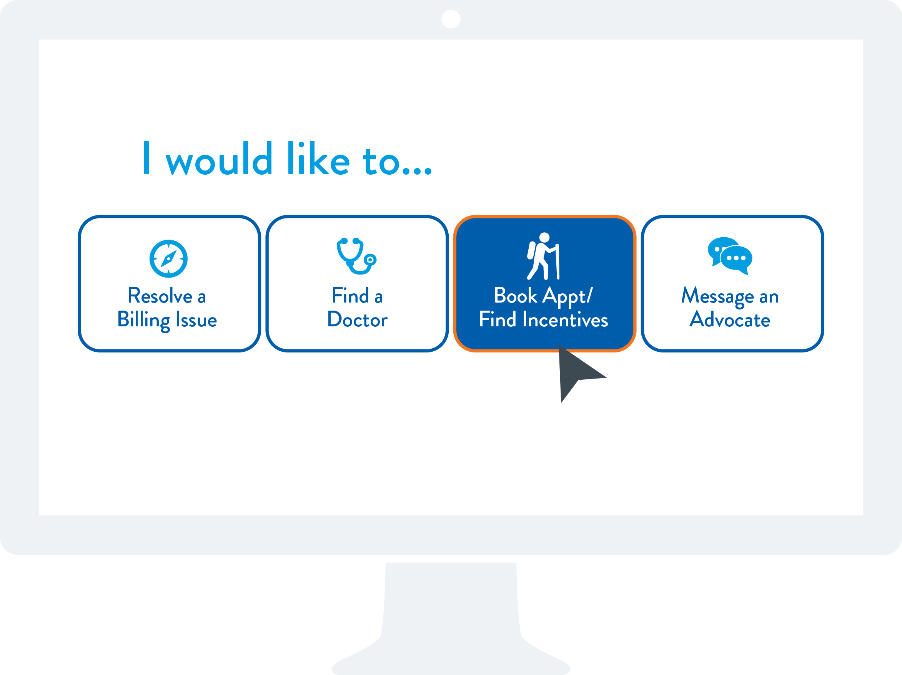
Health Navigator
24

Slide 25
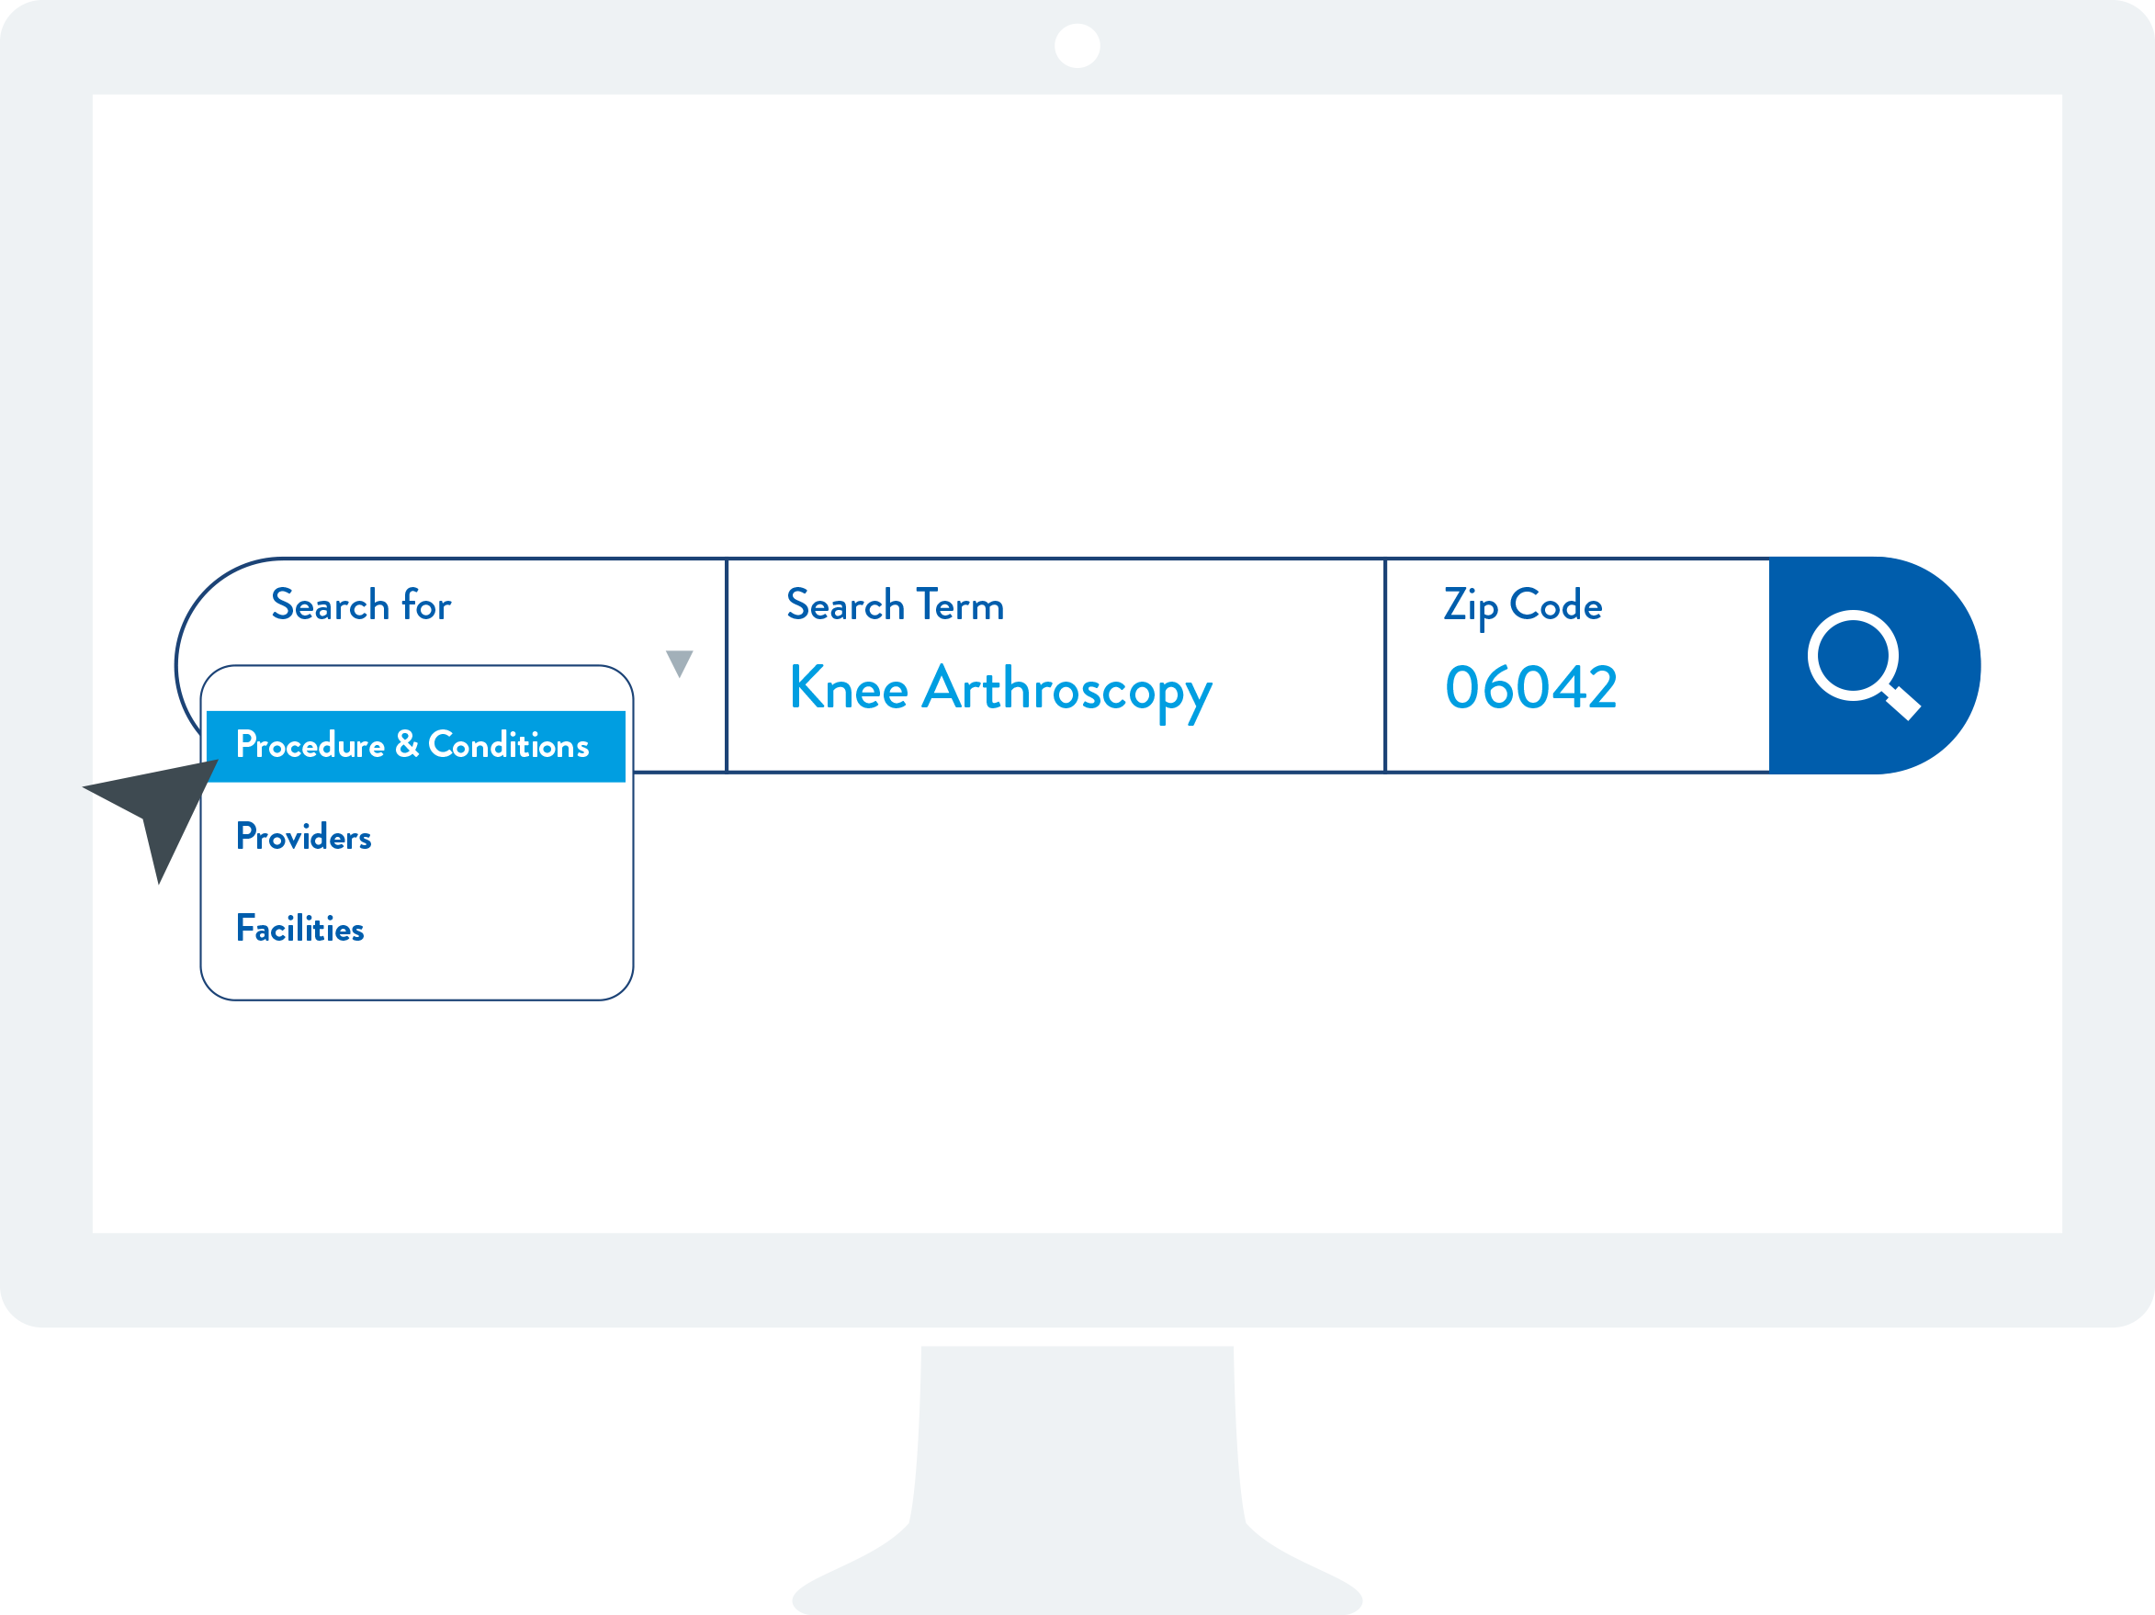
Health Navigator
Search Type
Gallbladder Surgery
25

Slide 26
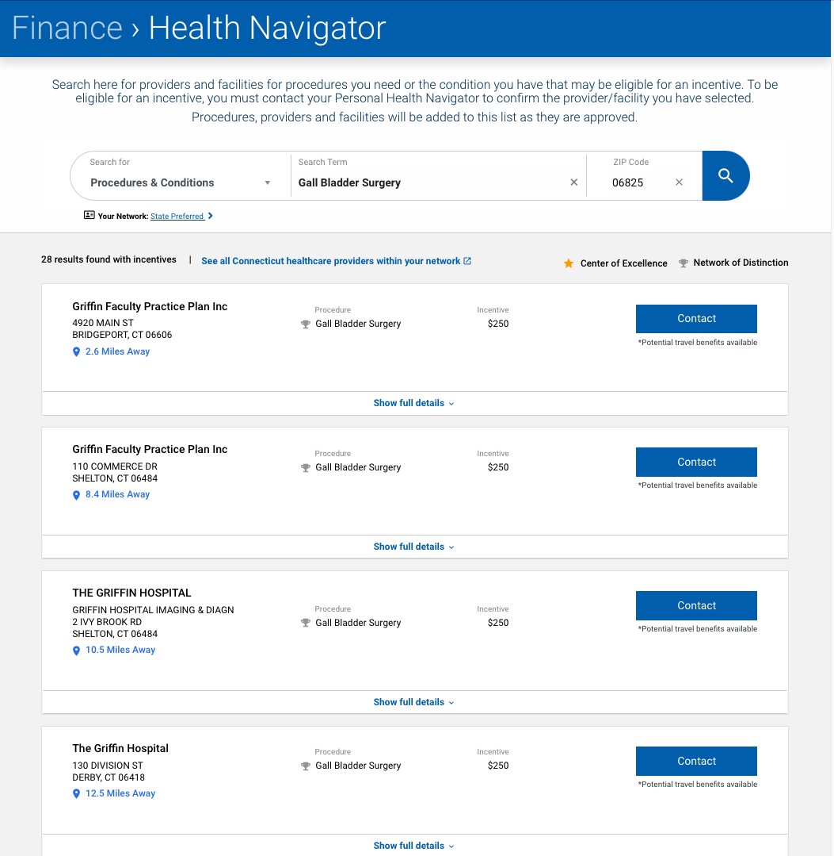
Health Navigator
26

Slide 27
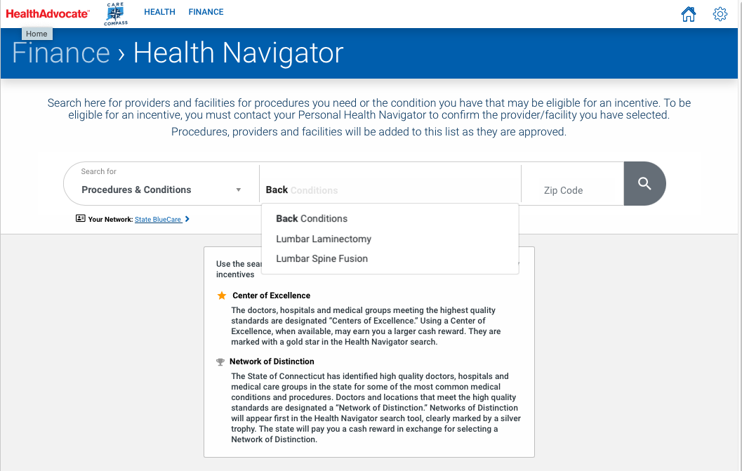
Support for Centers of Excellence
Health Navigator
27

Slide 28
Network of Distinction Incentive Program – Process
Member contacts Health Navigator to notify us that they are having a procedure / episode of care, and to provide the name of the provider
The provider submits the claim to Anthem, which processes the claim
Signify Health confirms incentive eligibility
Signify notifies Health Navigator, which submits the incentive for payment (paper check mailed to member’s home). This process could take up to 90 days from approval.

Slide 29
Thank You
Kelly Schraven
Senior Account Executive, National Accounts
KSchraven@HealthAdvocate.com
Amy McCarty
Client Services Manager
AMccarty@healthadvocate.com
29

