Slide 1
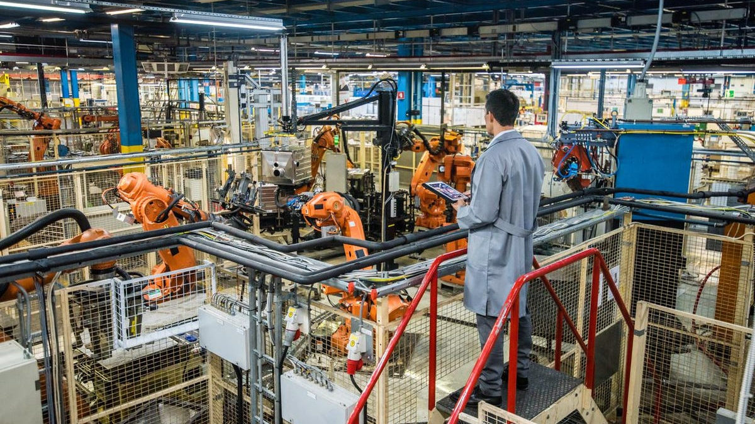
Looking for a long term career in Manufacturing?

Slide 2
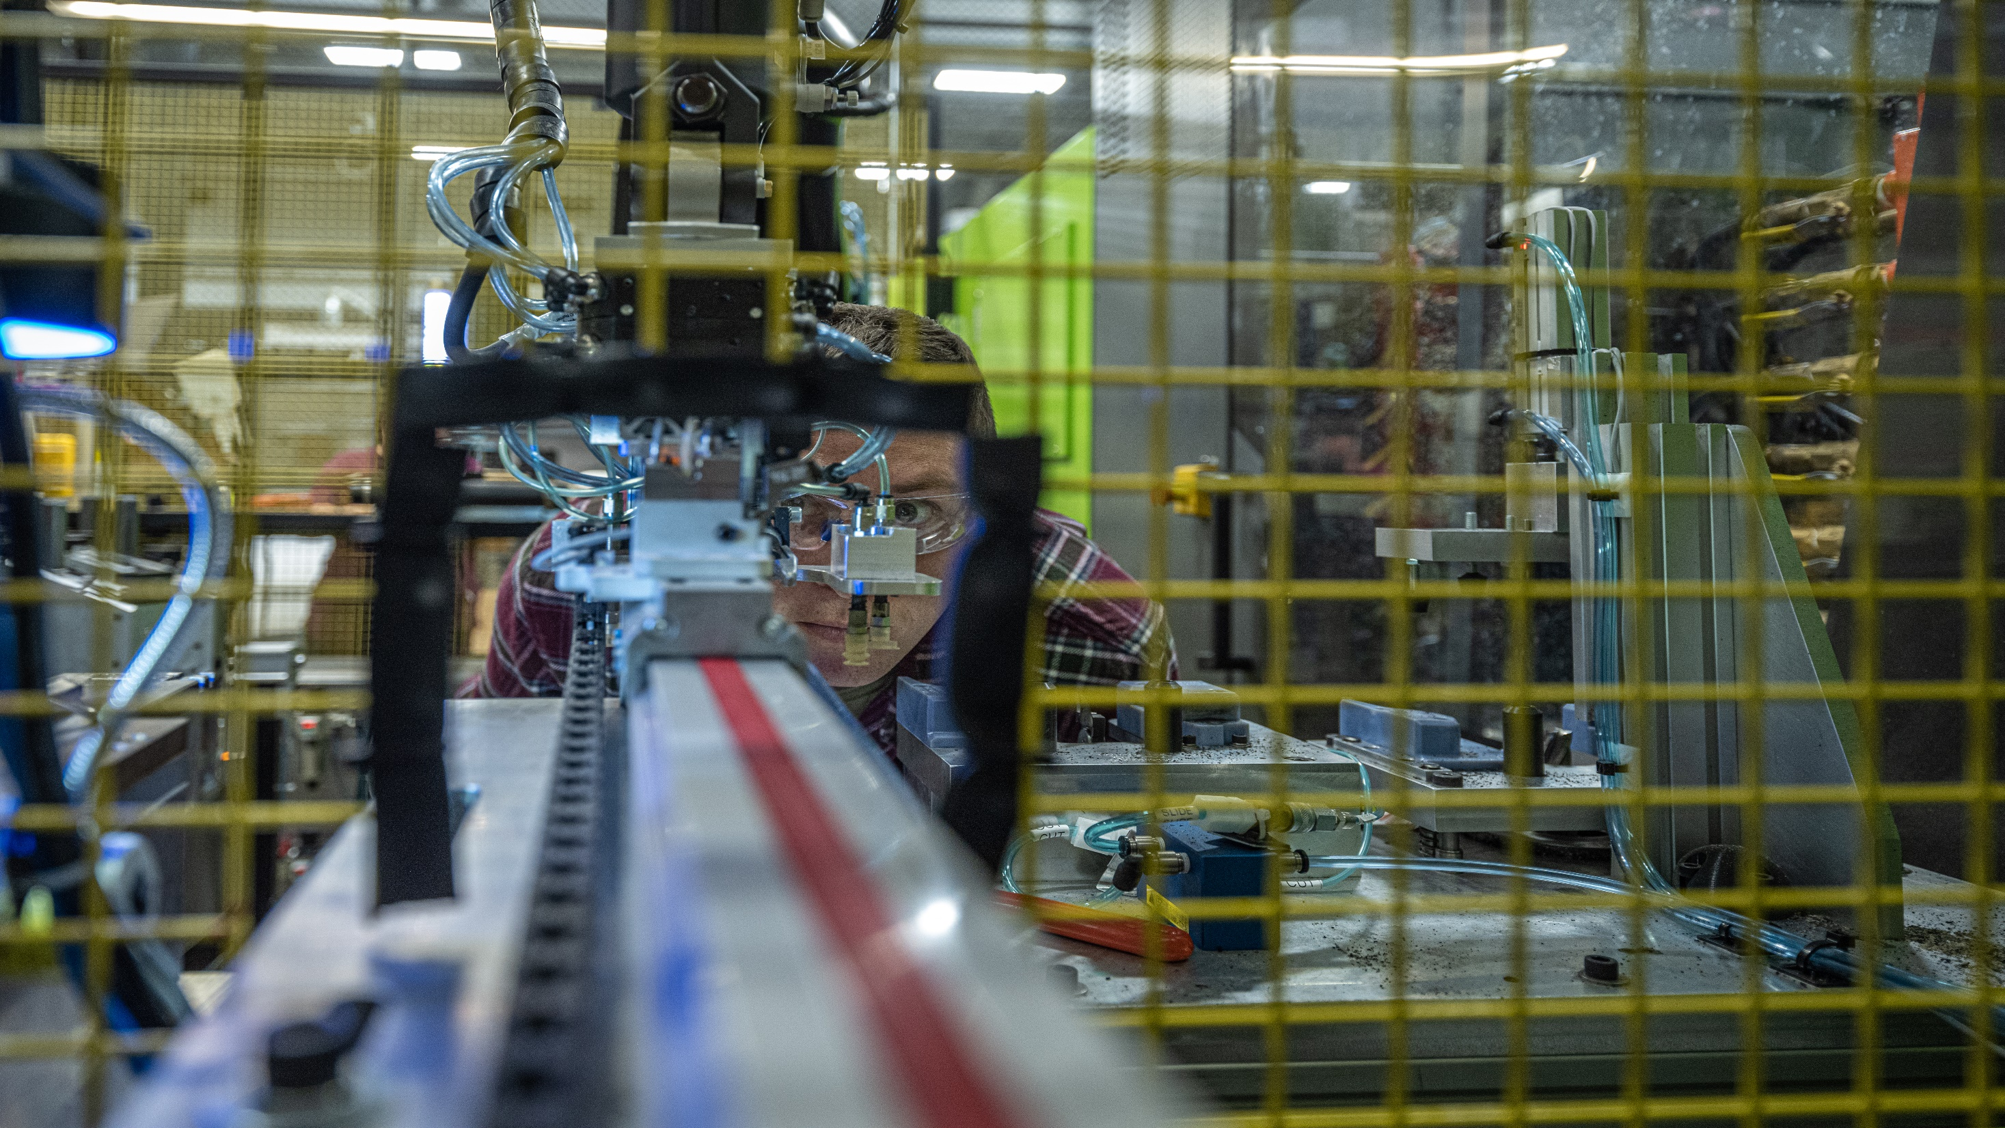
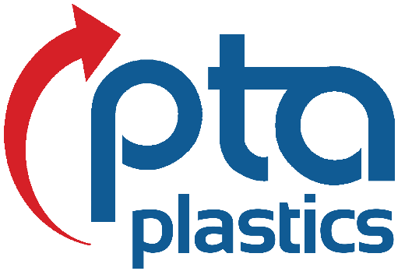
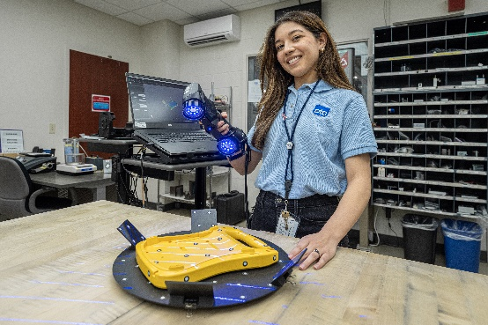
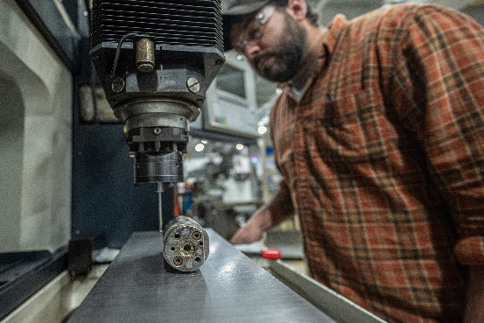
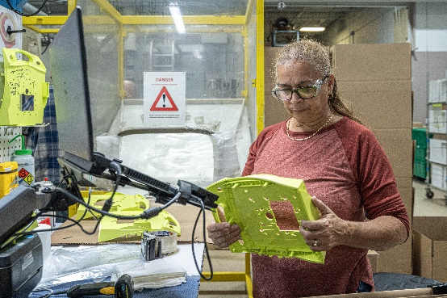
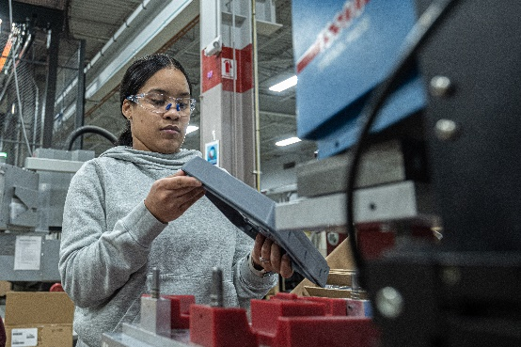
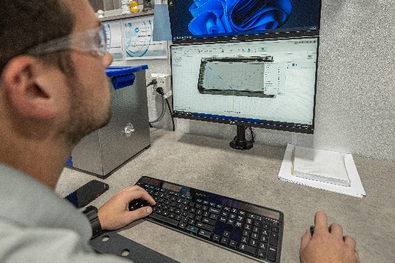
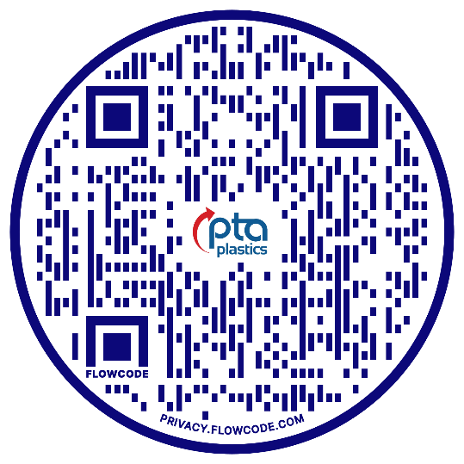
PTA Plastics is an Employee-Owned plastic injection molding company focused on product design and production.
With an emphasis on the medical, defense, and safety & security industries, PTA Plastics will help you find the solutions you need for your thermoplastic products.
Located: Oxford, CT

Slide 3
MEDICAL, DEFENSE, SAFETY &
SECURITY MARKETS
MANUFACTURER OF
EMPLOYEE-OWNED
LEADING EDGE THERMOPLASTICS
CONNECTICUT AND
COLORADO LOCATIONS
WINTER BREAK AND SUMMER INTERNSHIPS AVAILABLE!
www.ptaplastics.com
SCAN THE QR CODE TO
CONTACT US FOR A TOUR!

Slide 4
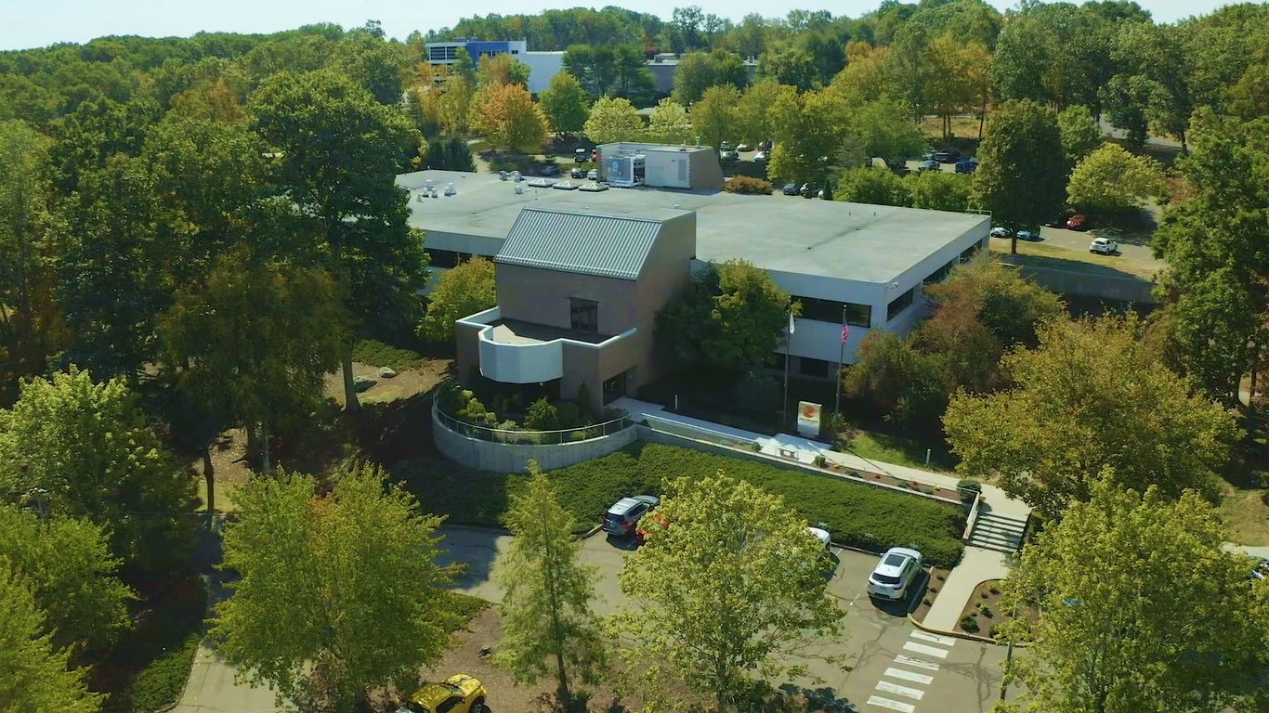
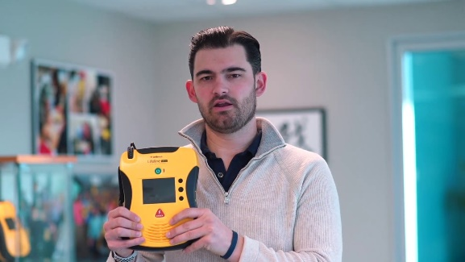
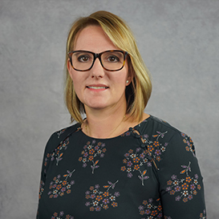
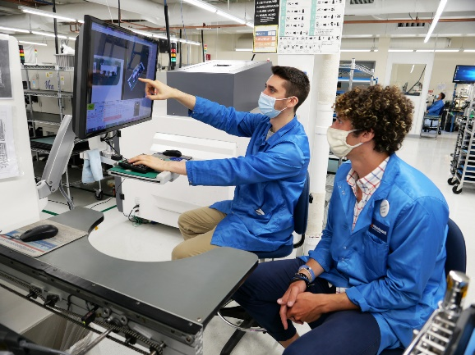
Nicole Russo
Owner, President & CEO
Microboard is an electronics manufacturing services provider delivering circuit card assembly, system integration, and test services. We work with medical, military, telecom and industrial customers on their life changing and life saving devices.
Join Microboard – a leading edge electronics manufacturer in CT!
Located: Seymour, CT

Slide 5
Microboard is a Manufacturer of High-Tech Electronics
Defense, Medical, Telecom Markets
Family Owned & Operated; 40 Years in Business
Year-Round, Winter Break & Summer Internships Available
Nicole Russo
Owner, President & CEO
Scan Me!
Contact us for a tour & discussion on
internships & career opportunities!

Slide 6
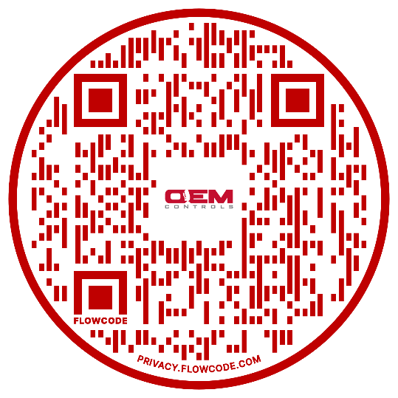
OEM Controls designs and manufactures rugged Joysticks and Electronics for Off-Highway equipment:
Construction
Utilities and Telecom
Emergency
Material Handling
Mining
Railroad
Agriculture
Internships Available! Contact Us

Slide 7
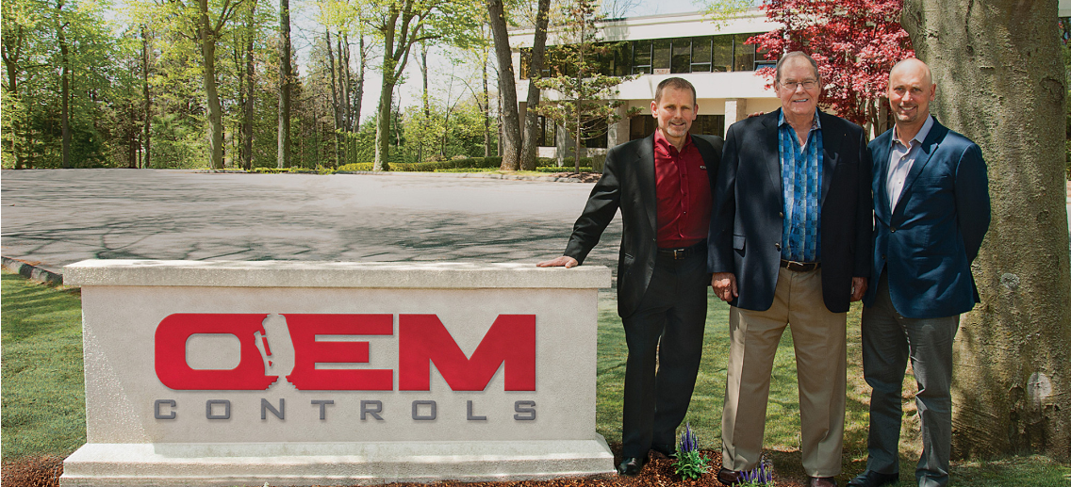
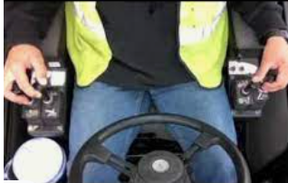
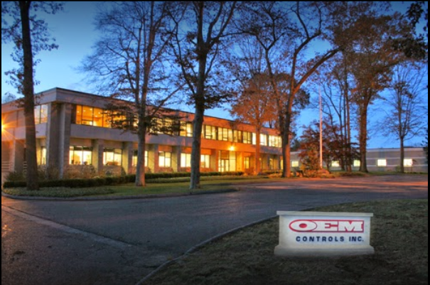
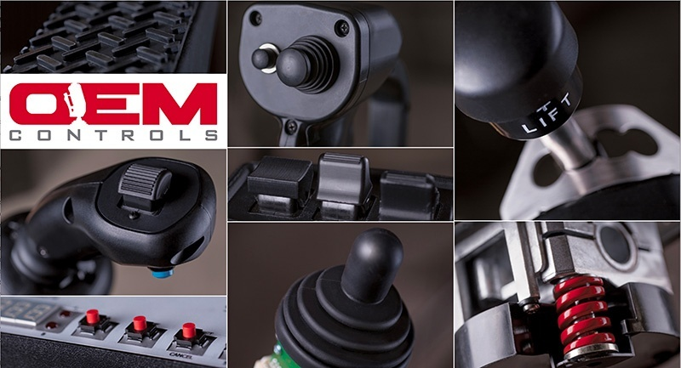
Shelton CT
Family owned and operated since 1966.
Careers in
Engineering
Mechanical & Electronic Assembly
Software Development
Fabrication, Machining, Welding
Finance & Accounting
Sales & Marketing
Quality & Data Analysis
Scan Me!

Slide 8
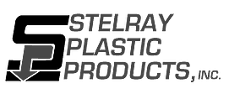
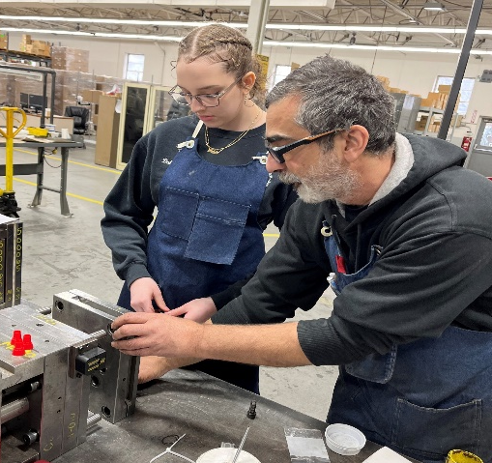
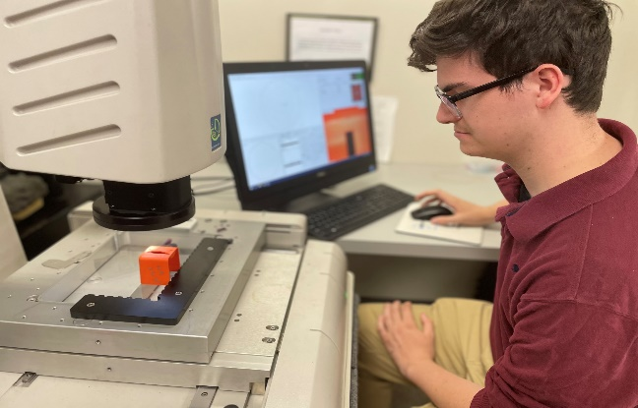
The Next Generation of Stelray Plastic Products, Inc. : A Plastic Injection Molding Company Offering Career Opportunities for Young Professionals
Mold your Future at Stelray Plastic Products, Inc.
Stelray is all about providing exceptional customer service and experience beyond the mold with every plastic injection molding job we run!

Slide 9
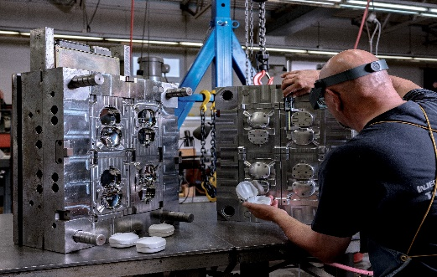
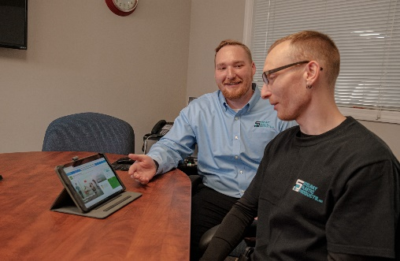
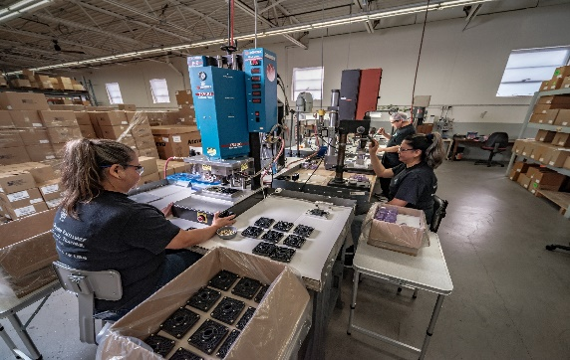
Why Stelray Plastic Products, Inc. is a Great Place to Work
Stelray is a family owned business looking for energetic team members. A few benefits working at Stelray Include…
Medical/Dental Insurance
Challenging & Fun Work Environment
Highly Competitive Wages
3-Shift Opportunities
401K Retirement Benefits
Mentor & Apprenticeship Opportunities
On the Job Training
Production Injection Molding
Mold Building
Prototyping

Slide 10
Welcome to
Modern Plastics
Joseph C. Carbone, Founder
We’ve been doing this for a very long time (and we’re very, very good at it!) Modern Plastics started in Bridgeport, Connecticut, in June 1945 when my grandfather Joseph C. Carbone opened the then, “Modern Glass Company“ – a one-man operation specializing in same-day installation of automobile window glass.

Slide 11
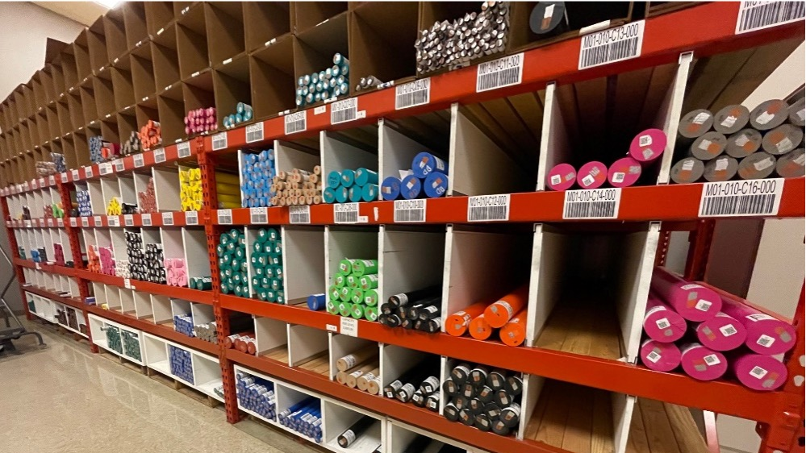
Looking for a challenging, exciting and financially rewarding career? We have sales, marketing, CNC equipment, plastics fabrication and warehouse position open.
Visit our website at modernplastics.com or e-mail me at Bing Carbone at bcarbone @ modernplastics.com
MODERNPLASTICS
I manage my business. My customers run my business.”
Bing J. Carbone, President
88 Long Hill Cross Road, Shelton, Connecticut 06484 USA

Slide 12
