Slide 1
Computer Science
Department
Master’s Proposal Presentation (590)
Title: Proposal Template
by
Candidate: Jane Doe

Slide 2
Computer Science
Department
Title: Proposal Template
Advisor : Jane DaProf, Ph.D.
2nd Reader : John DaRead, Ph.D.
ChairPerson : Jane LaProf, Ph.D.

Slide 3
Contents:
Introduction
Literature Review
Design
Methodology
Timeline
Contributions
References

Slide 4
1. Introduction
The Section titles (on the previous slide) are tentative
This Section could be also called Problem Definition or Problem Specification

Slide 5
1. Introduction
In this Section you would gently introduce the issue you are planning to address.
Start with the Background of the Problem
Describe the Problem is some detail

Slide 6
1. Introduction
Provide some current solutions.
End this Section with the paragraph stating that your project proposes to address (solve) this problem in some efficient manner

Slide 7
1. Introduction
While writing make sure that the proposal is ‘readable;’ having a smooth segue from one paragraph to another

Slide 8
1. Introduction
You are writing a scientific paper in IEEE format
Each statement must be either:
A common knowledge
A fact presented in another paper (reference to that paper needed [1])
A fact that is proven by your narrative

Slide 9
2. Literature Review
This Section can be called ‘State of the Art’.
In this section review each paper/document that you think is related to your problem and/or solution.
Present only papers that are relevant and if possible very recent.

Slide 10
2. Literature Review
Google Scholar is a good source [2].
Ask your advisor to obtain copies of papers that you need.
Reviewing Web online content is also desirable. (Especially software libraries and tools).

Slide 11
3. Design
In this Section you would address the idea/concept of the solution you are proposing
Typically you would develop a system with underlying modules.

Slide 12
3. Design
Describe the system specifications
Describe the modules’ functionalities.
Do use graphics to depict the system.

Slide 13
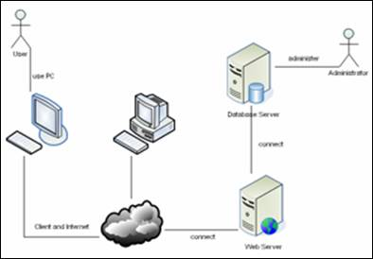
3. Design
Figure 1. my System Design
(deliberately blurred)

Slide 14
3. Design
Describe each module from the graphics.
Create additional diagrams: UML, Visio….

Slide 15
4. Methodology
In this section you would discuss the methods on how you would proceed with developing your system as a solution to your problem.
How do you plan to develop the system and its modules?

Slide 16
4. Methodology
For each module (from 3. Design) explain how you plan to develop it so it satisfies all the requirement specifications.
Any specific Platform, Hardware, API used.

Slide 17
5. Timeline
Specify your milestones.
Sept Lit Review
Dec Testing
Oct Prelim Code
Nov Code Complete

Slide 18
6. Contributions
Summarize in a couple of paragraphs who (or what) do you think would be the beneficiary of your provided solution.

Slide 19
7. References
[1] E.D. DaMaster, Systems and Others, in Journal of Knowledge, p120-122, 2018.
[2] Google Scholar, retrieved from https://scholar.google.com on April 1st 2018.

Slide 20
Computer Science
Department
This was a Master’s Proposal Presentation
Titled ‘Proposal Template’ by Jane Doe
Thank You
Questions?

