Slide 1

Computer Science
Department
Special Project Presentation (595)
Title: Special Project Template
by
Candidate: Jane Doe

Slide 2
Computer Science
Department
Title: Special Project Template
Advisor : Jane DaProf, Ph.D.
2nd Reader : John DaRead, Ph.D.
ChairPerson : Jane LaProf, Ph.D.

Slide 3

Contents:
Introduction w Problem Specifications
Review of Existing/Related Solutions
Project Design
Implementation
Testing Methodology
Test Results and Conclusions
Contributions
Future Work
References

Slide 4
1. Introduction
The Section titles (on the previous slide) are tentative
This Section should include Problem Definition and Problem Specifications

Slide 5
1. Introduction
In this Section you would gently introduce the issue you are planning to address and develop code for.
Describe the Issue and highlight the required specifications you want to be implemented.

Slide 6
1. Introduction
Provide some current solutions/applications for the issue.
End this Section with the paragraph stating that your project would provide a software/hardware solution to the issue in some efficient manner

Slide 7
1. Introduction
While writing make sure that the Special Project document is ‘readable;’ having a smooth segue from one paragraph to another

Slide 8
1. Introduction
You are writing a technical document in IEEE format
Each statement must be either:
  A common knowledge
  A fact presented in another paper (reference to that paper needed [1])
  A fact that is proven by your narrative

Slide 9
2. Review of Existing/Related Solutions
This Section can be called ‘State of the Art’.
In this section review each solution that you think is related to your issue.
Present only solutions that are relevant and if possible very recent.

Slide 10
2. Review of Existing/Related Solutions
Google Scholar is a good source [2].
Ask your advisor to obtain copies of papers that you need.
Reviewing Web online content is also desirable. (Especially software libraries and tools).

Slide 11
3. Design
In this Section you would address the idea/concept of the project you are planning to develop.
Typically you would develop a system with underlying modules.

Slide 12
3. Design
Describe the system specifications
Describe the modules’ functionalities.
Do use graphics to depict the system.

Slide 13
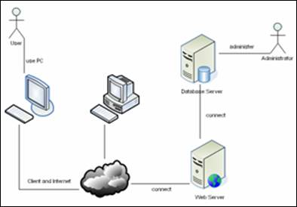
3. Design
Figure 1. my System Design
(deliberately blurred)

Slide 14
3. Design
Describe each module from the graphics.
Create additional diagrams: UML, Visio….

Slide 15
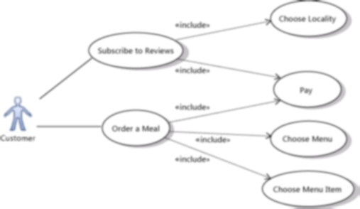
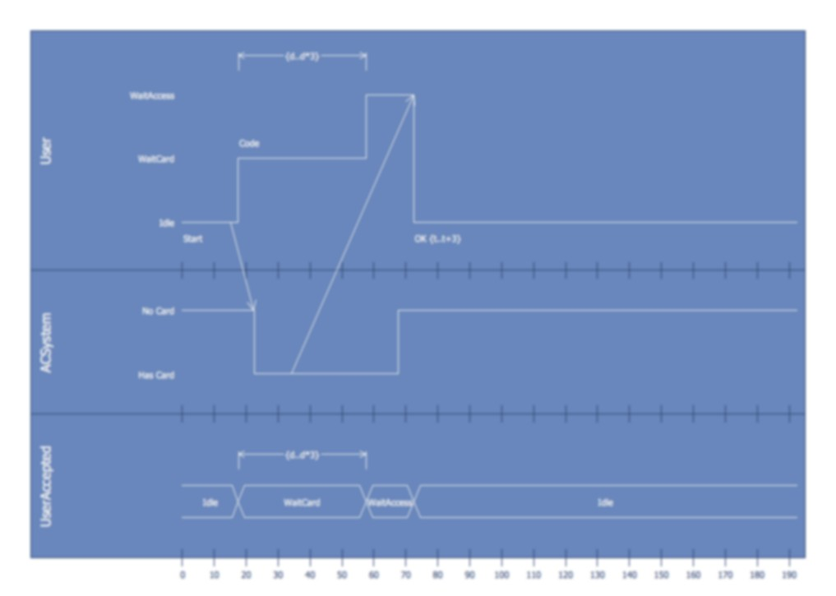
3. Design
Figure 2. a) Use Case b) Timings
(deliberately blurred)

Slide 16
4. Implementation
In this section you would discuss the technical details of your implementation
List your implementation platform details
Discuss pieces of your code. There is no need to discuss all the code: Select only important and interesting code snippets to discuss

Slide 17
4. Implementation
Did you encounter any difficulties: list and discuss those. Also describe how did you overcome the technical obstacles.
Describe code runs and types of code tests.
Code manual/usage pages are needed as well

Slide 18
4. Implementation
To calculate z we use calculate() function:
x = 3
y = 4
z = calculate(x,y)
Figure 3. my Function Call
(deliberately ambiguous)

Slide 19
5. Testing Methodology
In this section you would discuss the methods to measure the quality of your developed system.
How do you plan to test the system and its modules?

Slide 20
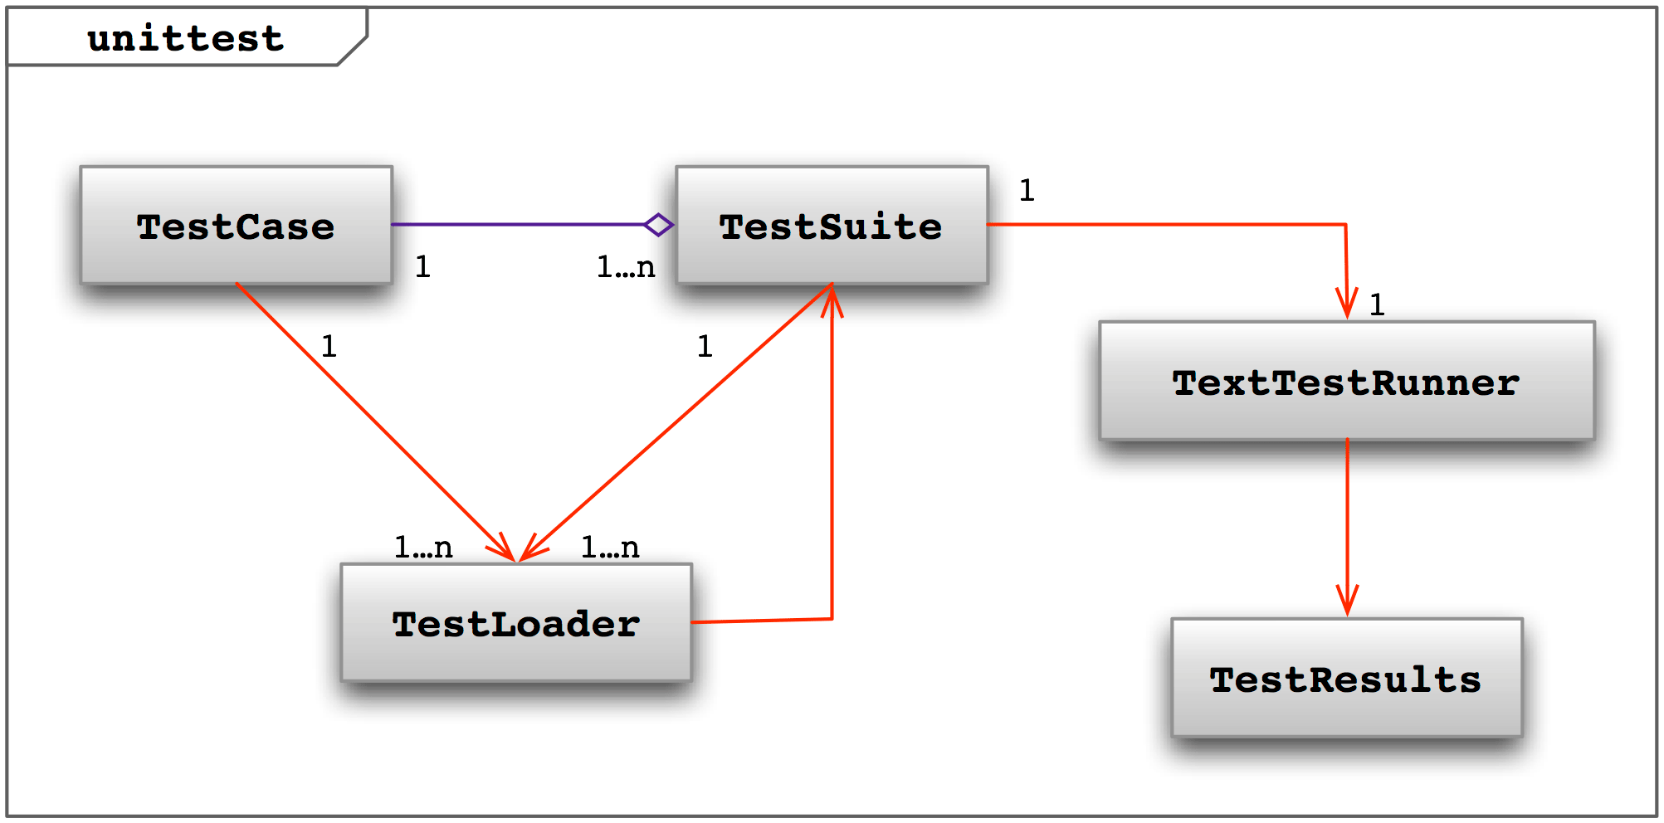
5. Testing Methodology
Explain how well your system satisfies all the requirement specifications.
Have you used any testing automation?
Figure 4. Test Modules
(deliberately blurred)

Slide 21
6. Testing Results and Conclusion
Start with describing your data collection process.
Why those specific measures of quality?
How much data?

Slide 22
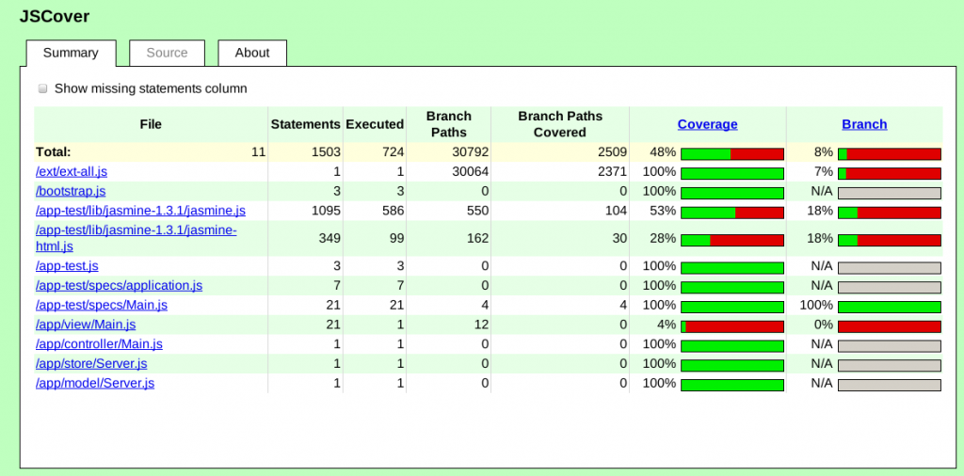
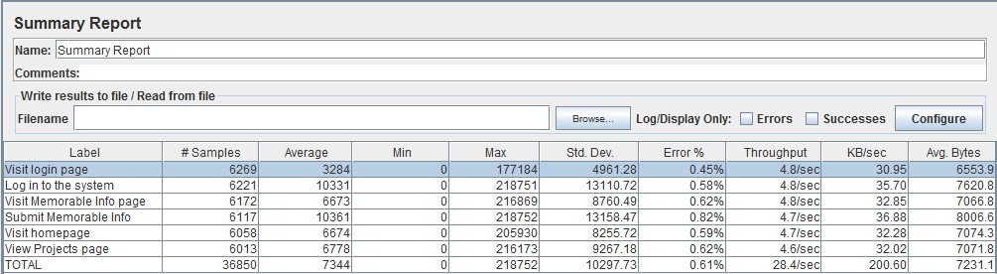
6. Testing Results and Conclusion
Summarize your results in a tabular format
Figure 5. a) Coverage b) Visits
(deliberately blurred)

Slide 23
6. Testing Results and Conclusion
Table 1. Resulting Table
(deliberately ambiguous)
Users: | 1 | 2 | 3 | 4
Speed | 1s | 2s | 3s | 4s
Memory | 2MB | 4MB | 6MB | 8MB
Disk | 3MB | 4MB | 9MB | 10MB
Power | 4W | 8W | 10W | 11W
Table 1. shows the results generated by my system program.

Slide 24
6. Testing Results and Conclusion
Each table needs to be discussed, and the conclusions about the presented results drawn.
End the Chapter with the final conclusions; the conclusions about all the resulting data and tables.

Slide 25
7. Contributions
Summarize who (or what) do you think would be the beneficiary of your provided solution.
Summarize how would that entity benefit from provided solution

Slide 26
8. Future Work
Here you would provide possible improvements to your solution.
Include features that you wanted to try but did not have time to try them out

Slide 27
9. References
[1] E.D. DaMaster, Systems and Others, in Journal of Knowledge, p120-122, 2018.
[2] Google Scholar, retrieved from https://scholar.google.com on April 1st 2018.

Slide 28
Computer Science
Department
This was a Master’s Special Project Presentation
Titled ‘Special Project Template’ by Jane Doe
Thank You
Questions?

