Slide 1
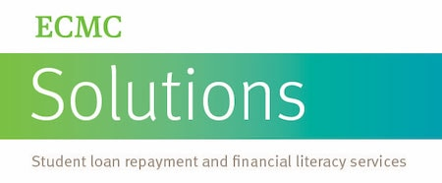
Be Wi$e with Money
Financial Literacy & Advising
https://inside.southernct.edu/financial-advising
Lew DeLuca
DeLucaL2@southernct.edu, 203-392-8862
Wintergreen Building 108E

Slide 2
$ Saving Tips
Track Expenses (Mint, YNAB)
Rental, used or digital books (Dean of Stud. & Buley)
Use student discounts (UNiDAYS, U-Pass)
Pay Unsub. loan interest now
Limit financial aid refunds: https://www.youtube.com/watch?v=-FE6hCNfJ8k
Use 1098-T for Tax Credit (up to $2,500/year)

Slide 3
Making $ Decisions: “Beware of little expenses. A small leak will sink a great ship” Benjamin Franklin
We make 6-10 Money Decisions Daily
$5 coffee/day = $1,825/year
Go To Class! $70
https://inside.southernct.edu/onestop/financial-aid/scholarships: Scholarships
https://www.youtube.com/watch?v=8jkri0AeZWQ:
Alexa von Tobel in One Life-Changing Class You Never Took

Slide 4
Your Spending Plan “Do not save what is left after spending, but spend what is left after saving” Warren Buffett
50% Essentials/Needs
30% Housing, 10% Groceries, 5% Utilities, 5% Transportation, Medical
20% Future/Goals
Automate Emergency Savings Fund (3-6 months living expenses),
Debt, Retirement
30% Lifestyle/Wants
Play (healthy gaming/gambling), Vacation, Charity
https://www.youtube.com/watch?v=6Ib-bdko5cE Budgeting

Slide 5
Student Loans
Borrow money now, repay with interest later
https://www.igrad.com/videos/how-to-nslds-video NSLDS
Nearly $27,000 = SCSU Undergraduate debt
Repay ~$300/month x 10 years including $7,500 interest ($34,500)
Student Loan Rule of Thumb: EARN>BORROW https://www.youtube.com/watch?v=tu1bGgOuyww&feature=youtu.be
FREE help from ECMC: https://inside.southernct.edu/onestop/financial-aid/student-loan-repayment

Slide 6
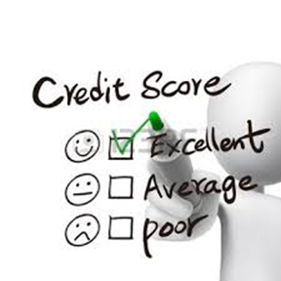
Credit Reports & Scores: Used by lenders, insurance co., landlords and prospective employers
Reports are FREE @ www.annualcreditreport.com
From Experian, Equifax & TransUnion annually
Prevent Identity Theft/Fraud
Report determines the score for 7-10 years
FICO score = financial reputation as a borrower

Slide 7
Credit Cards: Buy now, pay later. Credit = Latin for credere, “to trust”
Use card <30% of limit: no annual fee, rewards program (Bankrate.com & nerdwallet.com)
Pay bill in-full and on-time
---OR---
$1,000 bill @ 25% interest rate and pay $40 minimum for 7 yrs. & 2 mo. = $1,840
https://www.youtube.com/watch?v=qKHCOdH64Vo How to use

Slide 8
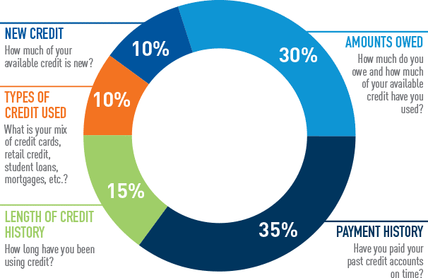
FICO Credit Score ( Fair Isaac Corp.)

Slide 9
Investing: Putting your $ to work “Don’t look for the needle in the haystack. Just buy the haystack” John Bogle
Roth/Traditional IRA, 401k/403b (co. match?), Pension
120 – Age = Stock %
Compound Interest
Penny doubled every day for month = $5,368,709.12
Rule of 72 to double your $ (ex. 72/6% = 12 yrs.)
Rule of 114 to triple your $ (ex. 114/6% = 19 yrs.)
Rule of 144 to quadruple your $ (ex. 144/6% = 24 yrs.)
https://www.reisupllc.com/your401k/compound-interest Reis Up
$5/day | 10% compounded
1 year | $1,885
40 years | $948,611

Slide 10
