Slide 1
State Employee Retirement System (SERS) C.G.S. § 5-152 et al.
Administered by the Office of the State Comptroller, State of Connecticut
www.osc.ct.gov

Slide 2
State Employee Retirement System Defined Benefit Plans (Amended by SEBAC 2009, 2011 and 2017)
Tier I
In general, applies to employees hired on or before July 1, 1984 who elected to participate in SERS Tier I Retirement Plans.
Three Plans: A, B and C
Tier II
In general, applies to employees hired between July 2, 1984 and June 30, 1997 who elected to participate in SERS Tier II Retirement Plan.
Tier II A
In general, applies to employees hired between July 1, 1997 and June 30, 2011 who elected to participate in SERS Tier II A Retirement Plan.
Tier III
In general, applies to employees hired between July 1, 2011 and July 30, 2017 who elected to participate in SERS Tier III Retirement Plan.
2

Slide 3
State Employee Retirement System Tier IV Defined Benefit / Defined Contribution Retirement Plans
Hybrid
In general, applies to employees hired between July 1, 2011 and July 30, 2017 who elected to participate in SERS Hybrid Retirement Plan.
*For ARP Members who transferred to Hybrid Plan should refer to the SERS retirement plan associated with date of hire.
Tier IV
In general, applies to employees hired on or after July 31, 2017 who elected to participate in SERS Tier IV Retirement Plans.
Employees are enrolled in two retirement plans:
Tier IV Defined Benefit
Tier IV Defined Contribution
3

Slide 4
State Employee Retirement System – Defined Benefit Plan Eligibility
Tier Plan | Early | Normal | Hazardous Duty
Tier I | Age: 55 years and 10 years Vesting Service | Age: 55 years and 25 Vesting Service OR Age: 65 years and 10 years Vesting Service OR Age: 70 years and 5 years Vesting Service | 20 years of Hazardous Duty service. No Age Minimum.
Tier II | Age: 55 years and 10 years Vesting Service | Age: 63 years and 25 Vesting Service OR Age: 65 years and 10 years Vesting Service or 5 years Actual Service OR Age: 70 years and 5 years Vesting Service | 20 years of Hazardous Duty service. No Age Minimum.
Tier II (Grandfather) | Age: 55 years and 10 years Vesting Service | Age: 60 years and 25 Vesting Service OR Age: 62 years and 10 years Vesting Service or 5 years Actual Service OR Age: 70 years and 5 years Vesting Service | 20 years of Hazardous Duty service. No Age Minimum.
Tier II A | Age: 55 years and 10 years Vesting Service | Age: 63 years and 25 Vesting Service OR Age: 65 years and 10 years Vesting Service or 5 years Actual Service OR Age: 70 years and 5 years Vesting Service | 20 years of Hazardous Duty service. No Age Minimum.
Tier II A (Grandfather) | Age: 55 years and 10 years Vesting Service | Age: 60 years and 25 Vesting Service OR Age: 62 years and 10 years Vesting Service or 5 years Actual Service OR Age: 70 years and 5 years Vesting Service | 20 years of Hazardous Duty service. No Age Minimum.
Tier III | Age: 58 years and 10 years Vesting Service | Age: 63 years and 25 Vesting Service OR Age: 65 years and 10 years Vesting Service | 25 years of Hazardous Duty service with no Age Minimum OR Age 50 years and 20 years of Hazardous Duty service
Tier IV | Age: 58 years and 10 years Vesting Service | Age: 63 years and 25 Vesting Service OR Age: 65 years and 10 years Vesting Service | 25 years of Hazardous Duty service with no Age Minimum

Slide 5
State Employee Retirement System – Defined Benefit Plan Eligibility
Tier Plan | Vested Rights | Disability
Tier I | Minimum 10 years Vesting Service or 5 years Actual Service * | Due to a Non-Service Connected injury or disability- 5 years of service
Tier II | Minimum 10 years Vesting Service or 5 years Actual Service * | Due to a Non-Service Connected injury or disability- 10 years of service
Tier II A | Minimum 10 years Vesting Service or 5 years Actual Service * | Due to a Non-Service Connected injury or disability- 10 years of service
Tier III | Minimum 10 years Vesting Service * | Due to a Non-Service Connected injury or disability- 10 years of service
Tier IV | Minimum 10 years Vesting Service * | Due to a Non-Service Connected injury or disability- 10 years of service
*Must wait until Age eligible.

Slide 6
State Employee Retirement System: Spousal, Survivor and Job Related Death Benefits (prior to retirement)
Spousal Survivor Pension Benefits
To be eligible, employee must have 25 years of service OR be eligible to retire under their retirement plan.
In general, benefit is calculated at 50%.
*Marriage must have been for at least 1 year at time of death*
Survivor Retirement Benefits
In lieu of defined pension benefits, beneficiaries (including spouses) may be entitled to receive the value of employee's contributions plus interest.
Job Related Death Benefits
Spouse with dependent child(ren) - $100,000 (paid in equal installments over 10 years or until remarried whichever is earlier) plus $50 a month per child up to age 18.
Spouse with no dependent children - $50,000 (paid equal installments over 10 years or until remarried whichever is earlier)
No Spouse or Children but dependent Parent: $50,000 (paid in equal installments over 10 years)
6

Slide 7
State Employee Retirement System: Defined Benefit Estimator
Each SERS Tier Retirement Plan has its own benefit formula stipulated in the plan summary and supplemental summaries. Use the Office of the State Comptroller’s Retirement Benefit Estimator- www.osc.ct.gov/empret/stateretire.htm
7

Slide 8
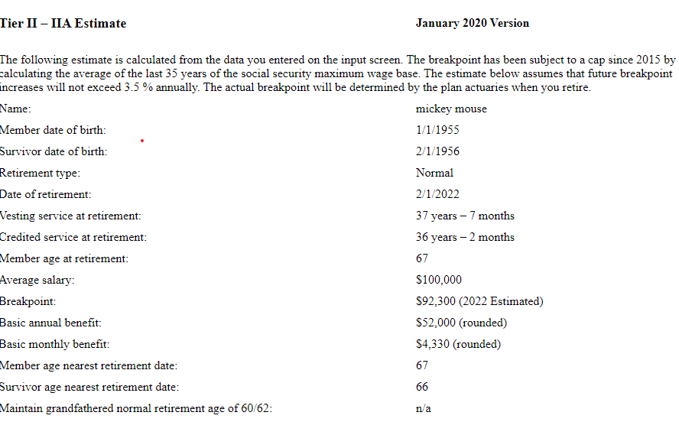
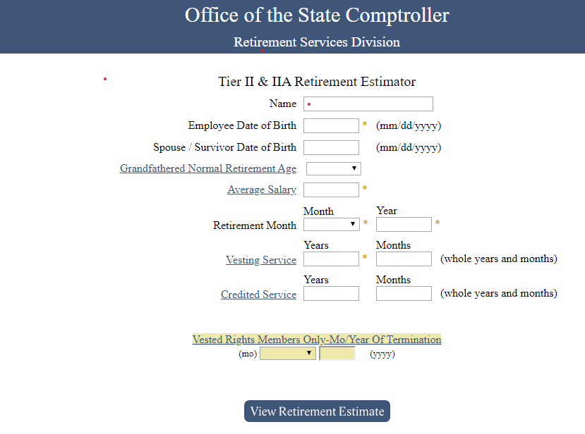
State Employees Retirement System – Estimate Your Benefit

Slide 9
State Employees Retirement System: Defined Benefit Payment Options (Irrevocable)
Option D – Straight Life Annuity
This option provides the retiree with the highest monthly benefit for the retiree’s lifetime. All payments stop upon the death of the retiree.
Option C – 10 Year or 20 Year Period Certain
This option provides the retiree and upon the death of the retiree, contingent annuitant(s) with guaranteed benefit for 10 years (120 payments) or 20 years (240 payments).
This is the only option that allows for multiple contingent annuitants.
Option A– 50% Spousal Annuity
This option provides the retiree with a reduced benefit and upon the death of the retiree a 50% benefit to the retiree’s surviving spouse.
*For marriages more than year prior to retirement, written spousal consent is required if the retiree does not provide a lifetime guarantee for that spouse*
Option B – 50% or 100% Survivor
This option provides the retiree with a reduced benefit and upon the death of the retiree either a 50% or 100% benefit to the retiree’s contingent annuitant (named annuitant could be the retiree’s surviving spouse).
9

Slide 10
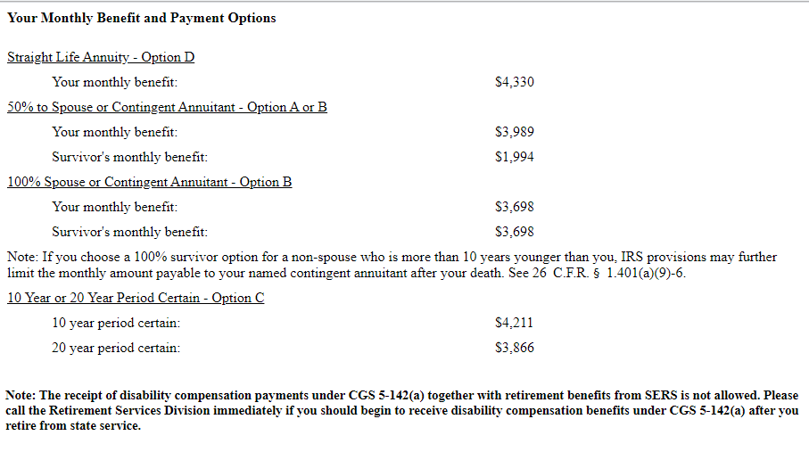
State Employees Retirement System – Estimate Your Benefit – Monthly Payment Options

Slide 11
State Employees Retirement System: Defined Benefit
Early Retirement Deduction
Early Retirement Penalty is permanent. The base monthly retirement amount does not increase when a member reaches normal retirement age.
Penalty: Reduction of .005 for each month the member retires early.
Survivor Option Reduction
The Internal Revenue Services (IRS) imposes limitations on a survivor that is more than ten years younger than the retiree.
If a retiree chooses the 100% annuitant option (non-spouse) who is more than ten years younger than the retiree, IRS provisions may further reduce the monthly payable amount.
26 C.F.R. § 1.401(a)(9)-6)
11

Slide 12
Retirement Cost of Living Increases
Employees who retire prior to July 1, 2022 are entitled to an annual fixed Cost of Living Increase minimum 2% maximum 7.5%. Employees must receive minimally 9 pensions checks to be eligible to receive their first COLA either in July or January.
Employees who retire on or after July 1, 2022 minimally must wait 30 months and the Cost of Living Increase is based on the Consumer Price Index for Urban Wage Earners and Clerical Workers (CPI-W).
When the CPI-W increases 2% or less then the COLA will be the actual increase in the CPI-W.
When the CPI-W increases by more than 2% then the COLA minimum 2% maximum 7.5% (60% of annual increase up to 6%; 75% of annual increase over 6%)
If within the first 18 months of retirement the CPI-W increases more than 5.5% then an additional COLA will be awarded based on an adjusted formula.
12

Slide 13
Retiree Health Benefits
Administered by the Office of the State Comptroller, State of Connecticut
www.osc.ct.gov

Slide 14
State Employee Retiree Health
Retiree Health Benefits
The State of Connecticut offers to eligible employees retiree health benefits upon retirement.
Retiree Health Benefits are offered to retirees and their qualifying dependents who are either non-Medicare or Medicare eligible.
Retiree health care benefits include medical, dental and prescription.
Eligibility for retiree health care coverage requires:
commencement of retirement benefits;
completion of a specified period of “Actual State Service”; and
for most employees, contributions to the retiree health fund.
Adjunct faculty members with sufficient actual state service to qualify for retiree coverage must pay Retiree Health Fund contributions as a condition of obtaining retiree health benefits. The payment plan is implemented at the time of retirement.
For ARP and Hybrid members who elect the cash-out option,
purchase of a lifetime annuity of $10,000 minimum is required to be eligible for retiree health coverage
14

Slide 15
State Employee Retiree Health – Actual State Service
Note: For part-time faculty, Actual State Service is determined by the number of load credits per semester. To qualify, a part-time faculty member must have at least 9 load credits per semester, which equates to a half-year of Actual State Service. No service credit is given to any semester with less than 9 load credits. To meet the 9 load credit threshold, all state service is counted for each academic semester. Thus, if an Adjunct Faculty member taught 6 load credits Fall 2019 at CCSU and 3 load credits Fall 2019 at Manchester Community College, then the Adjunct Faculty would receive a half-year service credit.
Tier I (vested on or before June 30, 1992) – members eligible for Early, Normal, Disability or Hazardous Duty retirement are eligible for retiree health coverage.
Tier I (vested on or after July 1, 1992) and Tier II- members eligible for Early, Normal, Disability or Hazardous Duty retirement are eligible for retiree health coverage so long as the member was covered by state-paid health benefits immediately prior to retirement.
Tier I and Tier II Deferred Vested Members – member will become eligible upon Early or Normal retirement provided the member has at least 10 years of vesting service and was covered by state-paid health benefits immediately prior to retirement.
Tier IIA hired between July 1, 1997 and June 30, 2009 – member with 10 years of Actual State Service who transitions directly from employment into Early or Normal retirement will be eligible for retiree health coverage.
Tier IIA (Grandfathered) – member who transitions directly from employment into Normal retirement at age 62 or older will be eligible for retiree health benefits with either 5 years of Actual State Service or 10 years of vesting service, but only if the member was actively employed by the state on April 21, 2009 and was age 52 or older as of July 1, 2009.

Slide 16
State Employee Retiree Health – Actual State Service cont…
Tier IIA hired between July 1, 2009 and June 30, 2011 – member with 10 years of Actual State Service who transitions directly from employment into Early or Normal retirement will be eligible for retiree health coverage.
Tier IIA Hazardous Duty or Disability Retirement – members are eligible for retiree health coverage upon retirement.
Tier IIA Deferred Vested with 10 years of Actual State Service as of July 1, 2009 - member will be eligible for retiree health benefits upon Early or Normal retirement.
Tier IIA Deferred Vested with 10 years of Actual State Service after July 1, 2009 - member must meet the Rule of 75 (combination of age and Actual State Service equals 75 or more) to be eligible for retiree health benefits.
Tier III and Tier IV – member who has 15 years of Actual State Service and transitions directly from employment into Early or Normal retirement will be eligible for retiree health benefits.
Tier III and Tier IV Deferred Vested with 15 years of Actual State Service - member must meet the Rule of 75 (combination of age and Actual State Service equals 75 or more) to be eligible for retiree health benefits.
Tier III Hazardous Duty or Disability Retirement – members are eligible for retiree health coverage upon retirement.

Slide 17
State Employee Retiree Health
Post-Retirement Death Retiree Health Benefits
If a member upon retirement selected a Spousal annuitant retirement option, then the Surviving Spouse may continue to receive retiree health benefits after the death of member.
Children, regardless of receipt of retirement benefits, will age out, unless deemed totally disabled.
If Surviving Spouse remarries while receiving retirement benefits then she/he will continue to be eligible; however, she/he cannot enroll new spouse.
*See Note re: Hybrid/ARP members
Pre-Retirement Death Retiree Health Benefits
Surviving Spouse is eligible if at the time of death the deceased member would have qualified for a pre-retirement death benefit.
For ARP and Hybrid (cash-out) Surviving Spouse must purchase a lifetime annuity of minimally $10,000.
For ARP, Surviving Spouse must be named beneficiary of the ARP account.
*Surviving Spouse must have been married to the deceased member at least 12 months preceding the date of death.
17

Slide 18
Retiree Health Benefits
Retirees who are not eligible for Medicare will enjoy the same health, prescription and dental benefits as active employee health, prescription and dental.
Retirees who are eligible for Medicare (including Spouses) must sign up for Part A and Part B upon their 65th birthday. Retirees who are eligible for Medicare will be automatically enrolled in the State of Connecticut Medicare Advantage Plan. Retirees will continue to enjoy our prescription plan.
State of Connecticut will reimburse for Medicare Part B upon proof of enrollment. Retirements effective July 1, 2022 or later, the State of Connecticut will no longer reimburse for the supplemental Medicare Part B assessed to employees who meet the income threshold.
Prior to enrolling in Medicare, both active employees and retirees should do nothing with respect to Medicare Part D. Do not waive or decline. State of Connecticut will enroll you in our retiree prescription plan.
Early retirement will result in additional monthly premiums, unless eligible for Medicare.
18

Slide 19
Retirement Tax Planning
Most states including the State of Connecticut taxes pension payments; however, presently some states do not such as New Hampshire.
Social Security may also be taxed.
Vacation and other accrual payouts may place you in a higher tax bracket.
19

Slide 20
Applying for Retirement
Retirement Documents
Common forms include:
Pension and retiree health option forms.
Medicare information, if applicable.
Pension Tax Forms
Birth Certificate(s)
Note: If you were born outside of the United States, you may need to have your birth certificate translated.
Marriage Certificate
Employee Retirement Income Security Act of 1974 (ERISA)
Provides to qualifying spouses including ex-spouses, a right to a retirement benefit.
An employee cannot waive their spouse’s or ex-spouse’s right to their retirement benefit. Only a Spouse or Ex-Spouse can waive his or her right.
All Spousal Waivers must be Notarized
20

Slide 21
THANK YOU

