Slide 1
Southern Connecticut State University Core-CT
Time and Labor Employee Self Service:
Running Attendance Report
Notes:
Instructions:
Thank your class for making the time to attend today’s class.
Next Screen:
Welcome

Slide 2
Overview – Attendance Report
Time & Labor Self Service allows you to run the Attendance Report
Self Service allows employees to run their own Attendance Report
One year’s worth of attendance can be printed on a report
Run Control is the name of your report
You can view, print or save your report
Notes:
Next Screen:
Key Points

Slide 3
Walk-through – Attendance Report
Step-by-Step Demonstration.
We will walk through the process together
Scenario: Attendance Report
Notes:
SCENARIO:
Maria Peeps would like to print her attendance report for the previous year.
Next Screen:
Navigation

Slide 4
Navigation – Attendance Report
From the Core-CT homepage click on:
Main Menu
Self Service
Notes:
Navigation:
Main Menu > Self Service > Time and Labor > Reports > Attendance Report
Next Screen:
Navigation (cont.)

Slide 5
Navigation – Attendance Report
Click on “Reports”
Notes:
Navigation:
Main Menu > Self Service > Time and Labor > Reports > Attendance Report
Next Screen:
Navigation (cont.)

Slide 6
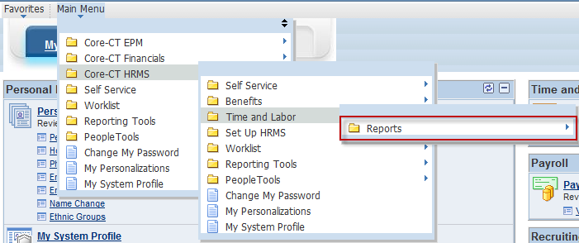
Navigation – Attendance Report
Next click on “Reports”
Click on “Attendance Report”
Notes:
Navigation:
Main Menu > Self Service > Time and Labor > Reports > Attendance Report
Next Screen:
Navigation (cont.)

Slide 7
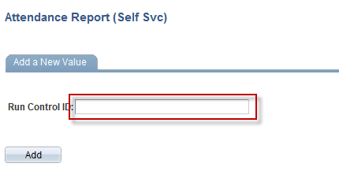
Attendance Report
A Run Control ID is the name of your report.
If running report for the first time you need to create a name for your report
The same name will be used to run all future attendance reports regardless of date range
Sample names
Attendance_Report
My_Attendance_Report
Click the “Add” button once your decided on a name and typed it in the Run Control ID field
Notes:
Information:
Add a New Value: If you have not previously run a report, use this option to create a new Run Control.
Instructions:
Enter a Run Control ID
Next Screen:
Attendance Report – Add a New Value

Slide 8
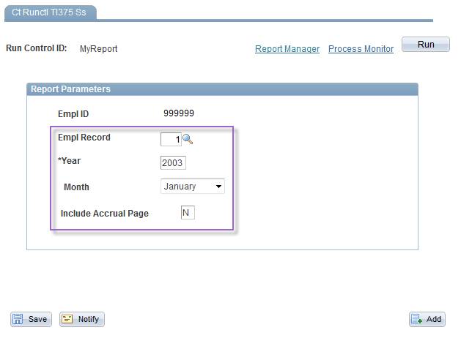
Attendance Report
If you have multiple jobs on campus you will need to run attendance reports for each job individually
Attendance Report includes 12 months worth of information
Use year and month fields to determine which 12 months will appear on the report
Month field determines the month the report will begin
If Include Accrual Page field is marked Y an accrual information page will process with your report.
Notes:
Information:
A new Run Control ID has default values as displayed.
Report Parameters help to expand or limit searches.
You can run a report for a one year period.
You can choose the month the report begins with.
You can elect to include the Accrual Page.
Next Screen:
Update Report Parameters

Slide 9
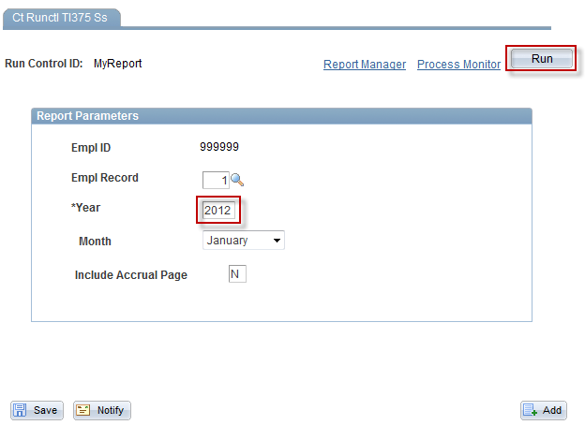
Attendance Report
Once the correct criteria is entered click on the “Run” button in the upper right hand corner of the screen.
Notes:
Information:
When you click Run, this report’s parameters are automatically saved.
Instructions:
Update the Year to 2012
Click the Run Button
Next Screen:
Process Scheduler Request

Slide 10
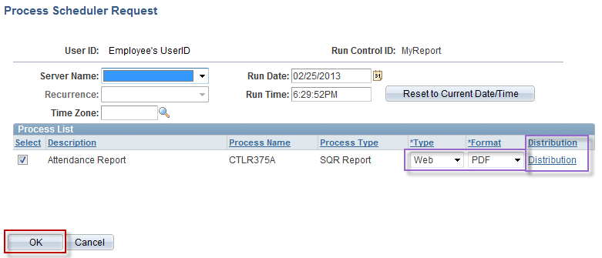
Attendance Report
Once Run is clicked you will be brought to the Process Scheduler Request screen
All fields are populated by the system and should not be changed
Simply click the OK button to run report
Notes:
Information:
The report defaults to a Web/PDF document. Either the Type or Format can be updated, as needed, by clicking the down arrow next to the default value.
You can add a UserID to send this report to by clicking on the Distribution link.
Special Note:
The Server Name should not be changed.
Instructions:
Click the OK Button
Next Screen:
Attendance Report Run Control page

Slide 11
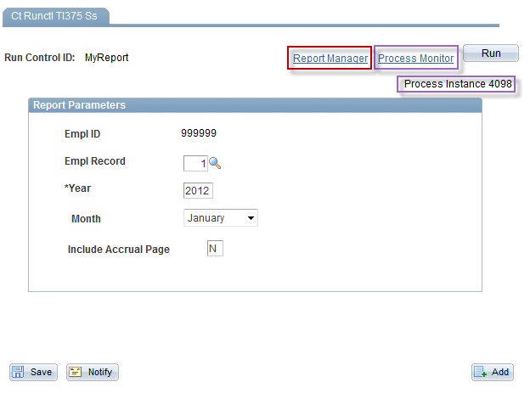
Attendance Report
A Process Instance Number has been created
Reports are saved by the system for 30 days.
This Process Instance number can be used to view this report for the next 30 days.
Click on the “Report Manager” link to access report
Notes:
Information:
Report Manager:
A. The report link will not populate on this page until it has run to success.
B. You can click the Refresh button until your report link populates, then click that link from the Report Manager page.
2. Process Monitor:
A. This link is mostly used when a report you ran is not populating on the Report Manager.
B. You can view the status of your report: Queued, Processing, Posted, No Success.
3. Process Instance number can be used to find the report again at a later date.
Instructions:
Click the Report Manager link.
Next Screen:
Report Manager (Report link)

Slide 12
Attendance Report
A Report may take up to two minutes to run
Periodically click the “Refresh” button until the report link appears below
Once created the report will be listed on the Report Manager page.
Access report by clicking the Report link
Notes:
Information:
When the Report link generates (i.e., CTTLR375), your report is ready for you to view.
Instructions:
Click the Refresh button until the Name link populates.
Click the CTTLR375 link.
Next Screen:
Report (file link)

Slide 13
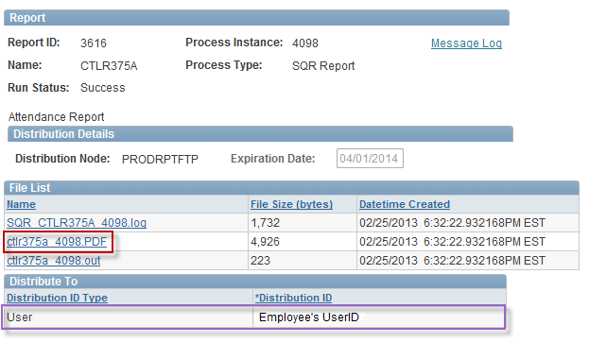
Attendance Report
Click on the .PDF link listed to view report
Notes:
Information:
Look for the link that contains an extension with the format requested (i.e., .PDF or .csv)
If other User IDs had been selected to receive the report, they would be listed under Distribute To.
Instructions:
Report: Click the cttlr375_4098.PDF link
Next Screen:
Attendance Report (results)

Slide 14
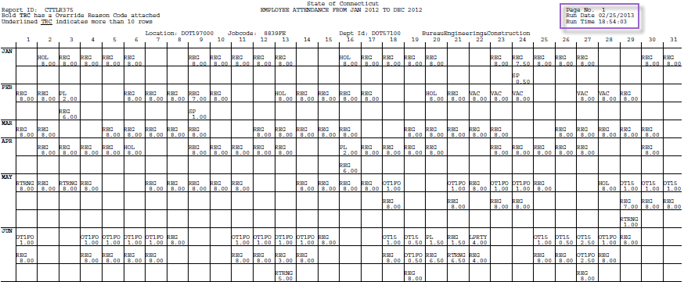
Attendance Report
Header includes date range for which the report was run as well as date and time processed
Days of the month appear across the top of the report and months appear down the side.
Report includes time that has been approved and paid.
Report can be printed or saved
Notes:
Information:
You can print, save, and close this report with the options at the top of your screen. Reports are only saved in Core-CT for 30 days.
The Page Number, Date and Time the report was run is displayed.
Employee Name and Employee Number are populated.
Up to ten rows of attendance information is displayed on each day. If the employee has more than ten rows of attendance the TRC for the tenth entry will be underlined.
Payable time with a status of PD (Distributed) or CL (Closed) will print to the report.
TRCs that begin with ‘X’ will not be displayed.
Next Screen:
Review

Slide 15
Review – Attendance Report
When running and/or viewing the Attendance Report, remember the following:
The Run Control is the name of your report.
Up to one year of attendance can be viewed on a report
You can choose to print accrual information
The report can be printed or saved
Only Payable Time with a status of Distributed or Closed will be displayed
Reports are saved in Core for 30 days
Notes:
Next Screen:
Knowledge Check

Slide 16
Knowledge Check – Attendance Report
Answer the following question:
What is a Run Control ID?
The name of your report
Do you need to manually save your report if you click Run?
No
What Payable Time status is displayed on the report?
PD (Distributed) and CL (Closed)
How many days is your report available in Core-CT?
30 days
Notes:
Information:
The name of your report
No
PD (Distributed) and CL (Closed)
30 days
Next Screen:
Overall Key Points

Slide 17
Questions
Questions?
Payroll Department
Beata Winiarski - Payroll Coordinator - (203) 392-5425
Ken Pereira - Payroll Officer - (203) 392-5427
Kommaly Xayasone – Payroll Clerk- (203) 392-5079
Linda D'Addio - Payroll Clerk - (203) 392-5621
Notes:
Information:
Perform exercises as desired.
Encourage them to ask for assistance if needed.
Instructions:
1. Stroll around room and assist users as needed.
Next Screen:
None – End of presentation

