Slide 1
Southern Connecticut State University Core-CT
Time and Labor Employee Self Service:
Enter Comments
Notes:
Instructions:
Thank your class for making the time to attend today’s class.
Next Screen:
Welcome

Slide 2
Overview – Entering Comments
Core-CT provides a way for you to document and view information on the Timesheet, such as why a TRC was changed.
The Timesheet Comments icon is located in the Reported Time Status link on the Timesheet
You can enter up to 32,000 characters per row for a Comment
You can add unlimited rows for a Comment if 32,000 characters is not enough
You can not delete a Comment once it is saved
The Timesheet does not need to be submitted or go through the Time Admin process in order for the Comment to be permanently saved
You can add additional comments at any time
Notes:
Next Screen:
Key Points

Slide 3
Walk-through and Exercise - Entering Comments
Step-by-Step Demonstration.
First, we will walk-through the process together
Scenario: Enter a Comment on a Timesheet
Notes:
SCENARIO:
Maria Peeps corrected her Exception.
She is returning to her 2/21/13 Timesheet to note in the Comments that she changed the SFAM entry to VAC in order to clear those exceptions.
Next Screen:
Navigation

Slide 4
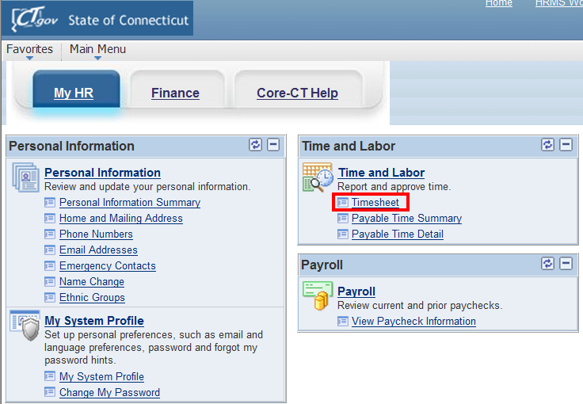
Entering Comments
Begin by clicking on Timesheet on the CORE homepage to access the Timesheet.

Slide 5
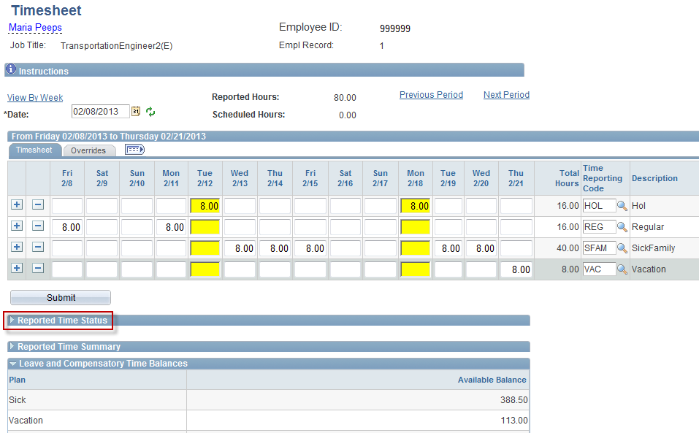
Entering Comments
Click on “Reported Time Status” to enter comments or access previously saved comments.
Notes:
Information:
1. Reported Time Status: You can enter comments or view the status of
submitted entries.
Instructions:
Click the Reported Time Status link.
Next Screen:
Reported Time Status

Slide 6
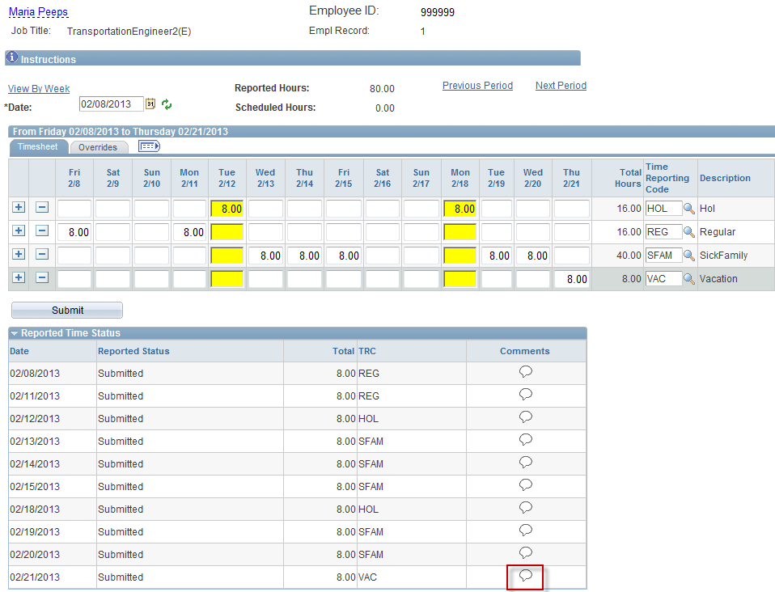
Entering Comments
Comments are accessed or added for each entry by clicking on the corresponding entries comment icon
Shaded icon: a comment has been entered
White icon: no comments exist for that entry
Notes:
Information:
White Comments icon: No comments have been entered.
Shaded Comments icon: Comments have been entered.
Instructions:
Ask: Have Comments been added for this time period? (No)
Click the Comments icon for 2/21/13.
Next Screen:
Comments

Slide 7
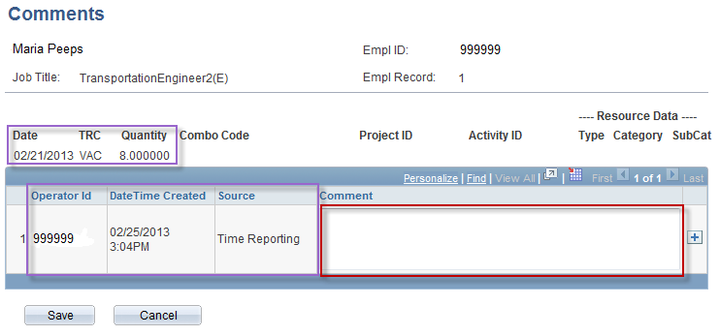
Entering Comments
Clicking an icon takes you to the comments screen for that entry. On this screen Date, TRC code and quantity of hours are listed.
Comments are entered here. If one day has multiple TRC entries the comment for one TRC will appear for all TRC’s included in that day.
Authors Operator ID, date and time created and source (Timesheet, Approval or Adjust Paid Time) are recorded.
Notes:
Information:
Date, TRC, Quantity the comment was entered for. This is the row’s date on which you clicked the Comments icon.
The Comments page stores the author’s Operator ID, the date and time the comment was created and where it was entered (Timesheet, Approval or Adjust Paid Time Page). All comments saved for a particular day are viewed regardless of where it was created.
If one day has multiple TRCs, comments entered for one of the TRCs will appear for all TRCs. Comments are saved by TRC, not by the date.
Instructions:
Enter your comment.
Next Screen:
Comments – Save button

Slide 8
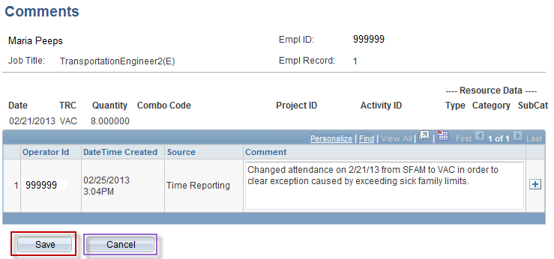
Entering Comments
Once comment is entered click the Save button.
Clicking the Save button permanently saves the comment.
A comment can’t be deleted once saved
Notes:
Information:
Click the Save button to permanently save the comment.
Click the Cancel button to exit without saving the comment.
Instructions:
Click the Save button.
Next Screen:
Comments verification page

Slide 9
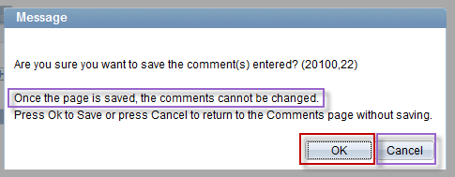
Entering Comments
After the save button is clicked you will be brought to this screen.
Click “OK” to permanently save the comment.
Click Cancel to not save comment
The usage of appropriate wording and facts is strongly suggested. Be clear with all comments so they can be understood by whoever views them.
Notes:
Information:
Once you save a comment, it is permanent.
The usage of appropriate wording and facts is strongly suggested.
Cancel button: A. Use to cancel (not save) a comment you just entered. B. Use when you have viewed a previously saved comment.
Instructions:
Click the OK button.
Next Screen:
Timesheet

Slide 10
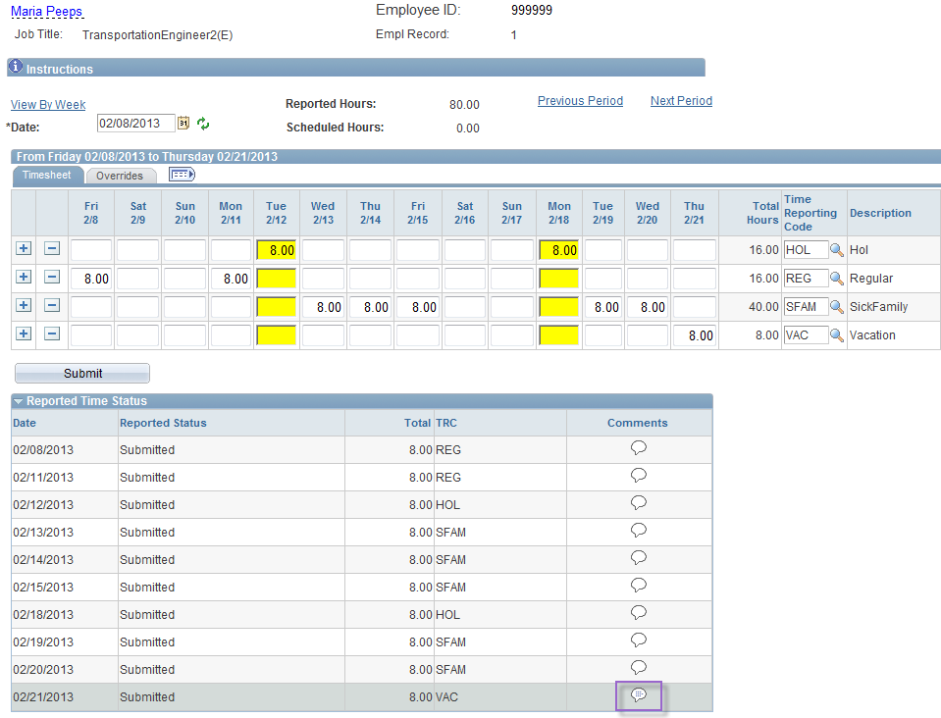
Entering Comments
Once comment is saved the comment icon will appear shaded.
Notes:
Information:
Shaded Comment icon: The comment was saved.
You do not need to Submit the Timesheet to save a comment.
Next Screen:
Review Comments

Slide 11
Review – Entering Comments
When entering Timesheet Comments, remember the following:
The Timesheet Comments icon is located in the Reported Time Status link on the Timesheet
You may enter up to 32,000 characters per row; you can click the + (Plus) icon to add another row for the same comment
You can not delete a saved comment
You can return to a comment to enter additional information
You do not need to submit the Timesheet for the Comments to remain saved
If a comment has been entered on a date that has multiple Timesheet entries, a shaded Comments icon will appear beside each row of that date’s attendance
When viewing comments, all comments for a particular day will be displayed regardless of what page the comment was entered from
Notes:
Next Screen:
Knowledge Check

Slide 12
Knowledge Check – Entering Comments
Answer the following questions:
When is the Comments icon white and when it is shaded?
White when no comment is present
Shaded when a comment has been saved
Can you delete a saved comment?
No! Comments cannot ever be deleted once submitted
How can you add additional information for an existing comment?
Multiple comments can be added to the same day by clicking the plus (+) button for each new comment.
Notes:
Information:
1. White = No Comments
Shaded = Comments saved
2. No
3. Comments page:
A. Click Plus button (+).
B. Enter additional comment.
C. Click Save button.
Next Screen:
Agenda

Slide 13
Questions
Questions?
Payroll Department
Beata Winiarski - Payroll Coordinator - (203) 392-5425
Ken Pereira - Payroll Officer - (203) 392-5427
Kommaly Xayasone – Payroll Clerk- (203) 392-5079
Linda D'Addio - Payroll Clerk - (203) 392-5621
Notes:
Information:
Perform exercises as desired.
Encourage them to ask for assistance if needed.
Instructions:
1. Stroll around room and assist users as needed.
Next Screen:
None – End of presentation

