Slide 1
Southern Connecticut State University Core-CT
Time and Labor Employee Self Service:
View Payable Time Detail
Notes:
Instructions:
Thank your class for making the time to attend today’s class.
Next Screen:
Welcome

Slide 2
Overview - View Payable Time
Time & Labor Self Service allows you to view payable time.
View the Payable Time Status
Needs Approval
Approved
View UserID of Approver and date/time of approval
Notes:
Next Screen:
Process Flow

Slide 3
Process Flow - View Payable Time
Time needs to be revalidated
Errors?
Employee
Enters
Time
Time Admin
Validates
Time
Manage
Exceptions
Yes
View Payable Time
No
Approve
Time
Time
Ready for
Payroll
Notes:
Next Screen:
Key Points

Slide 4
Key Points - View Payable Time
When viewing payable time, remember the following:
The payable status is as current as of the most recent Time Administration process run
Time Administration Process is an overnight process run by the State Comptroller’s Office
Only time that is clear from exceptions (errors) is displayed on the Payable Time pages
Exceptions can be viewed on the Timesheet
Time with a status of “Needs Approval” is not loaded to Payroll and will not be paid
Notes:
Next Screen:
Walk Through

Slide 5
Walk-through and Exercise - View Payable Time
Step-by-Step Demonstration.
First, we will walk-through the process together
Scenario: View Payable Time Detail
Path Reminder: Time and Labor pagelet > Payable Time Detail
Notes:
SCENARIO:
Maria Peeps corrected her exceptions and entered Comments on her Timesheet yesterday.
Now she is going to the Payable Time Details page to see if those Exceptions cleared.
Next Screen:
Navigation

Slide 6
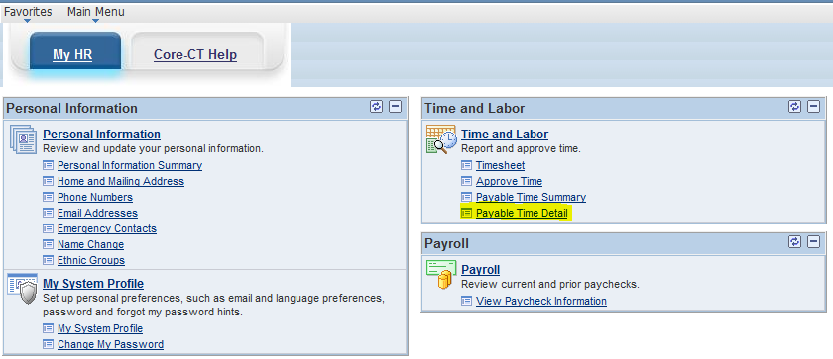
Navigation - Viewing Payable Time Detail
Click on “Payable Time Detail” link
Notes:
Information:
View up to 31 days on Payable Time Detail page
End Date defaults as today’s date.
Start Date defaults as seven days before the End Date.
Update the Start and End Date to view other time periods.
Next Screen:
Payable Time Detail – Start Date

Slide 7
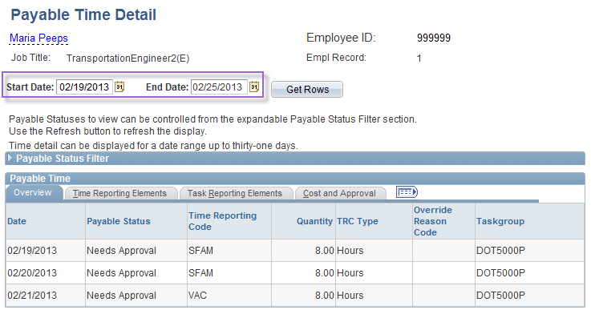
Navigation - Viewing Payable Time Detail
View up to 31 days on Payable Time Detail page
End Date defaults as today’s date.
Start Date defaults as seven days before the End Date.
Update the Start and End Date to view other time periods.
Notes:
Information:
View up to 31 days on Payable Time Detail page
End Date defaults as today’s date.
Start Date defaults as seven days before the End Date.
Update the Start and End Date to view other time periods.
Next Screen:
Payable Time Detail – Start Date

Slide 8
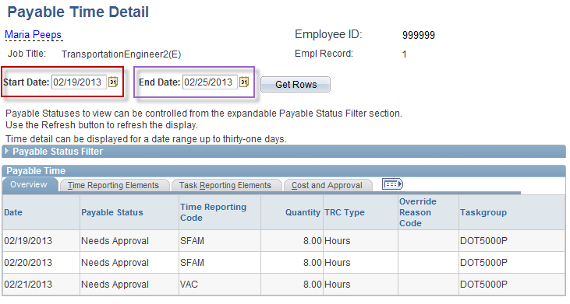
Navigation - Viewing Payable Time Detail
Start Date can be updated either by typing in a date or using calendar icon
End Date defaults to the current date
Click on “Get Rows” to view information for dates requested
Notes:
Information:
Update the End Date if necessary. In this example, the End Date is beyond the pay period end date and does not need to be updated
Instructions:
Change the Start Date to 02/08/13.
Next Screen:
Payable Time Detail – Get Rows

Slide 9
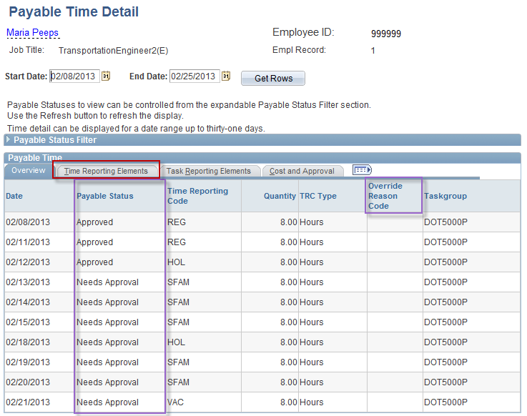
Viewing Payable Time Detail
There are Four Payable Status
Needs Approval – has not been approved by Supervisor
Approved – Time has been entered and approved
Taken – Used by Payroll – Time has been collected by Payroll but not processed
Distributed – Time has been paid
Notes:
Information:
Status notes: A. Needs Approval: Time Admin has processed the entry as valid but it has not been approved by the Time Approver. B. Approved – Goes to Payroll: The entry has been processed as valid, approved by the Time Approver and will be collected by Payroll. C. Taken – Used by Payroll: The Payroll process successfully collected the entry but Payroll confirm has not run yet. D. Distributed: The entry has been processed by Time Admin, approved by the Time Approver, collected during the Payroll Admin process and paid out during Payroll Confirm. *** This status populates Monday of pay week.
Override Reason Code – optional field provides more information about the attendance.
Instructions:
Click Time Reporting Elements tab.
Next Screen:
Payable Time Detail – Time Reporting Elements tab

Slide 10
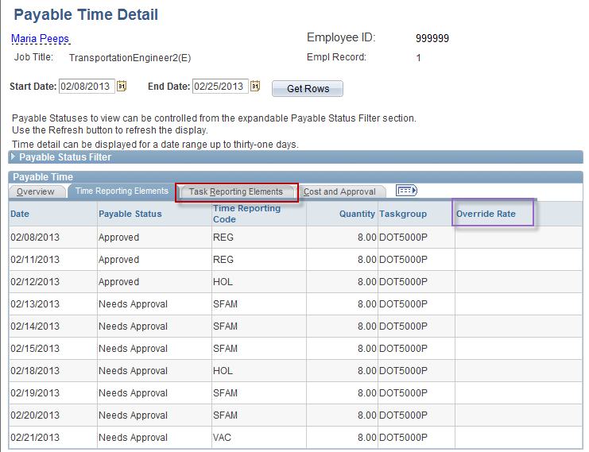
Viewing Payable Time Detail
Override Rate will populate by the system if the employee has overtime or unpaid time during this pay period
Notes:
Information:
Override Rate = if employee’s regular hourly rate has been changed the new rate will display here.
This field will be populated by the system if employee has overtime or unpaid time during the pay period.
Next Screen:
Payable Time Detail – Task Reporting Elements tab

Slide 11
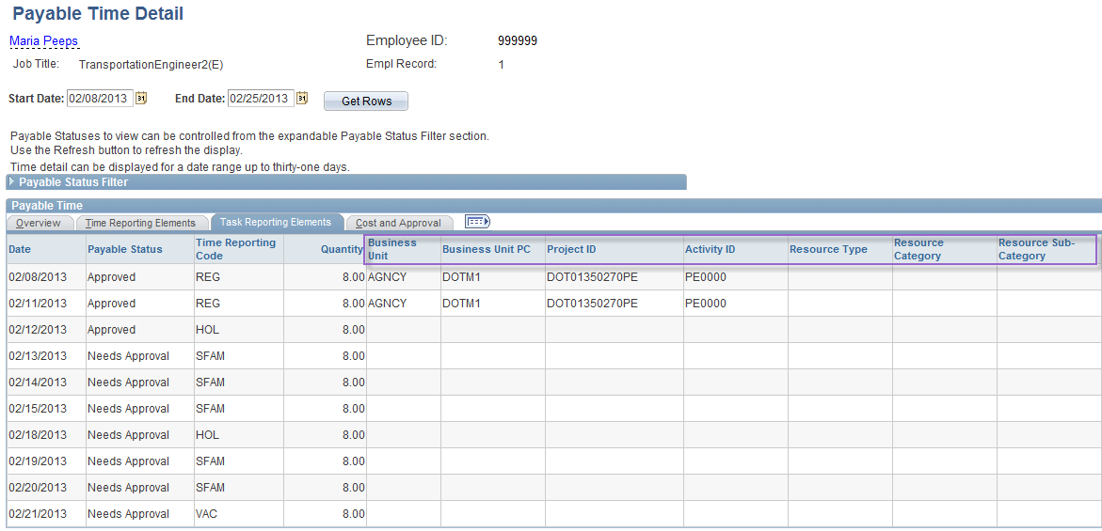
Viewing Payable Time Detail
Accounting Information will appear on the Time Reporting Elements Tab if hours are charged to a department other than the employees home department.
Scroll Right
Notes:
Information:
If a Combo Code had been entered on the Timesheet, the corresponding account information would be displayed here.
Next Screen:
Payable Time Detail – Scroll Right

Slide 12
Viewing Payable Time Detail
Scroll Left
Notes:
Information:
Workers Comp Claim Number – if entered on the Timesheet, it will be displayed here.
Combination Code – if a combo code had been entered on the Timesheet, it would be displayed here.
The Chartfields link provides more account information.
Next Screen:
Payable Time Detail – Chartfields link

Slide 13
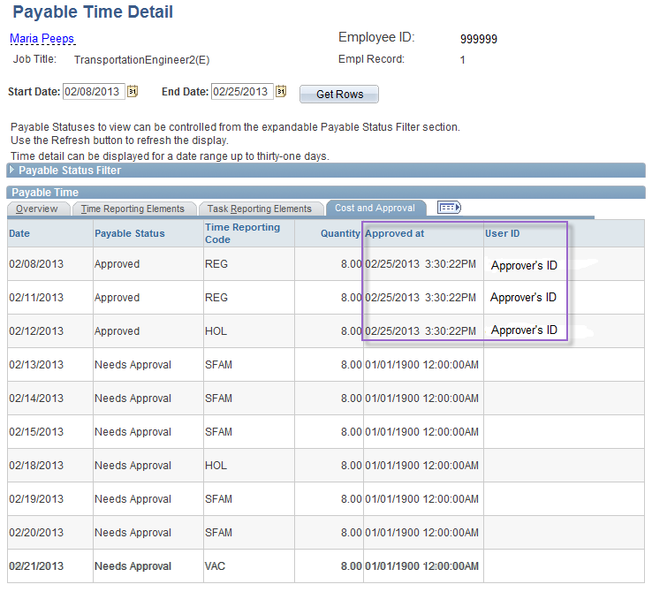
Viewing Payable Time Detail
Employees can verify who approved their time and when
The Approve at field shows the date and time of approval
User ID field shows User ID of person who approved time
Notes:
Information:
Employees can verify who approved their time and when.
The Approve at field shows the date and time of the approval.
The User ID field shows the UserID of the person who approved the time.
Next Screen:
Review – Viewing Payable Time

Slide 14
Review - Viewing Payable Time
When viewing time, remember the following:
The payable status is current as of the most recent Time Administration process run
Only time that is clear from exceptions is displayed on the Payable Time pages
All entered time, including updates, must be validated and approved to be collected during Wednesday night’s biweekly Payroll process
Only time with a status of “Approved – Ready for Payroll” will be loaded to Payroll
You can view each TRC’s Payable Time’s Status, total hours summary, Override Rate, Claim Number and Combo Code information
Notes:
Next Screen:
Knowledge Check

Slide 15
Knowledge Check - Viewing Payable Time
Answer the following questions:
1. When is time populated on the Payable Time pages?
After the Time Administration process runs overnight
2. You can view Combo Code information on which tab?
The Task Reporting Elements tab
3. When you navigate directly to Payable Time Detail, how many days display?
Up to 31 days
Notes:
Information:
After the Time Admin process runs.
Task Reporting Elements tab
Up to 31 (7 days when linked from Payable Time Summary page)
7
Next Screen:
Agenda

Slide 16
Questions
Questions?
Payroll Department
Beata Winiarski - Payroll Coordinator - (203) 392-5425
Ken Pereira - Payroll Officer - (203) 392-5427
Kommaly Xayasone – Payroll Clerk- (203) 392-5079
Linda D'Addio - Payroll Clerk - (203) 392-5621
Notes:
Information:
Perform exercises as desired.
Encourage them to ask for assistance if needed.
Instructions:
1. Stroll around room and assist users as needed.
Next Screen:
None – End of presentation

