Slide 1
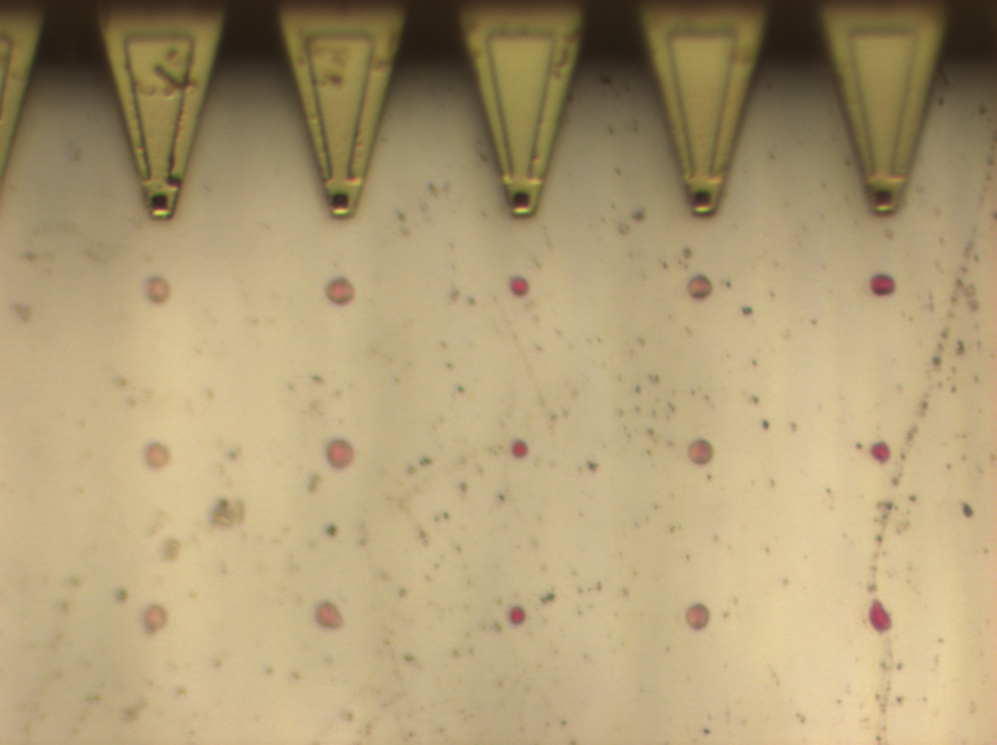
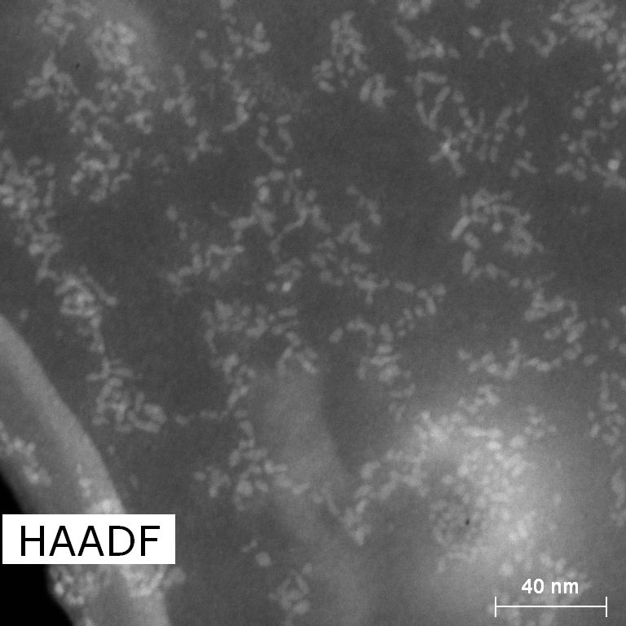
Be sure to include the SCSU logo on your poster!
Suggested Title font size 66pt
Suggestions for Images, graphs, and tables
Depending on the size font used for Title: Suggested Authors font size 36 pt ~ 44pt
See posters on wall of lower level academic science building for visual of actual size
Author Affiliations font size 28pt ~ 32 pt
SECTION HEADER:
Suggested Header font size 36pt~44pt
SECTION HEADER
Suggested Body font size 28pt~32pt
Figure 2: actual image size is 5”x8”
Caption: Suggested font size 20pt ~24pt
Figure 4: actual photo size is 4.44”x4.55”
Not sure of font size? Try typing the same sentence
Using various sized fonts (example below)and printing it out on paper.
This will help you see how big it is when printed.
Font size 20pt
Font size 24pt
Font size 28pt
Font size 32pt
Font size 36pt
Font size 40pt
Font size 44pt
Font size 48pt
Font size 54pt
Font size 60pt
Font size 66pt
SECTION HEADER
Acknowledgements

